Slide 1


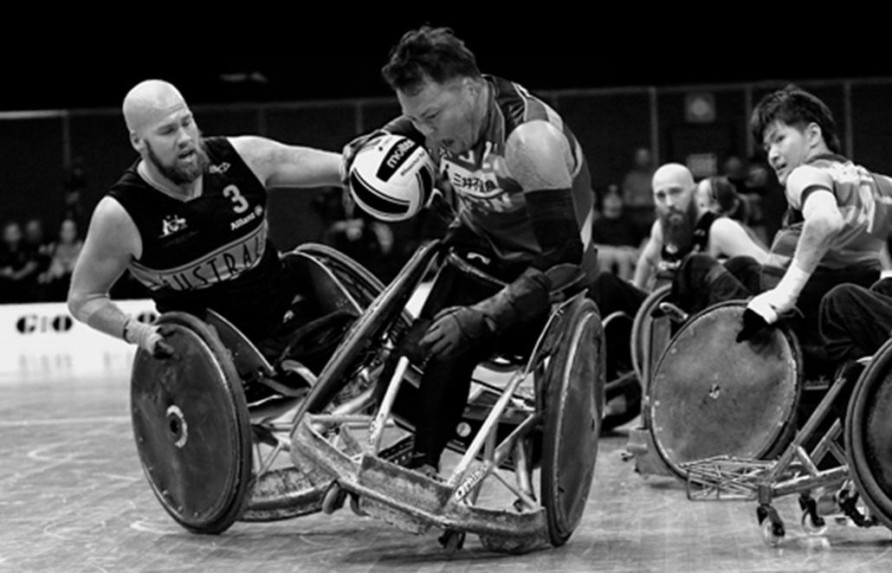
WWR Classification Workshop

Slide 2


Theory Session Overview
Welcome & Introduction
Classifier Eligibility & Pathway
Principles of Classification
WWR Classification System
Athlete Eligibility
Physical Assessment
Technical Assessment
Observation Assessment
Class Profiles
Protests

Slide 3



Slide 4

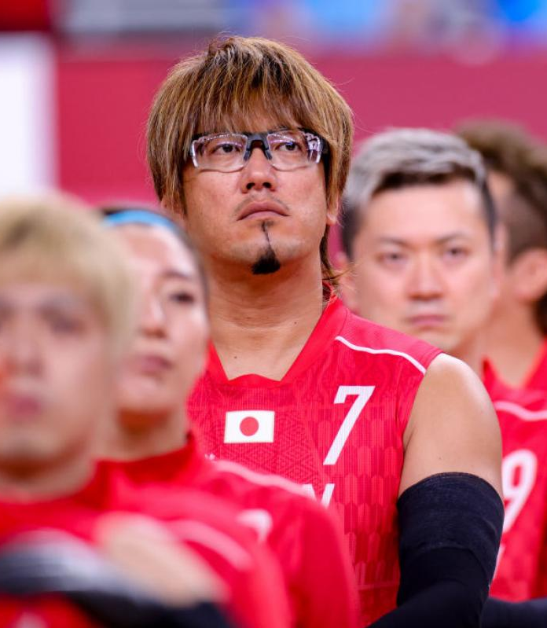
Bronze Medal – Japan

Slide 5
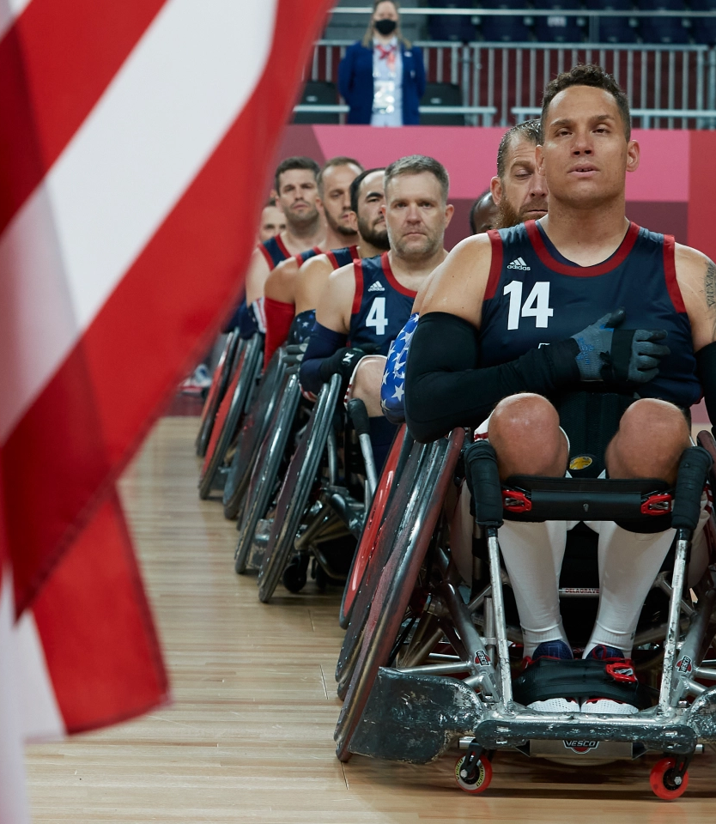
Silver Medal – USA

Slide 6
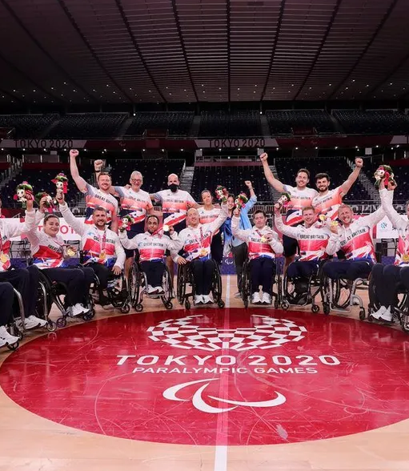
Gold Medal – Great Britain

Slide 7

Classifier Competencies
a thorough understanding of these Classification Rules;
an understanding of Wheelchair Rugby, including an understanding of the technical rules of the sport;
an understanding of the Code and the International Standards; and
professional qualification(s), level of experience, skills and/or competencies to act as a Classifier for the WWR.

Slide 8
Classifier Eligibility
A Classifier
a certified health professional in a field relevant to the Eligible Impairment category, which WWR at its sole discretion deems acceptable, such as a physician, physiotherapist/physical therapist, or occupational therapist;
OR
A Technical Classifier
has extensive athletic, coaching, or other relevant background in wheelchair rugby; or a recognised and reputable academic qualification, which encompasses a requisite level of anatomical, biomechanical and sport- specific expertise, which the WWR at its sole discretion deems to be acceptable.

Slide 9
Classification Panel
3 classifiers
OR
2 classifiers
+
1 technical classifier
Only Classifiers with a valid health professional qualification are certified to perform the physical assessment. All certified Classifiers may perform the technical and observation assessment in accordance with article 4.3.4 in Classification Rules.

Slide 10
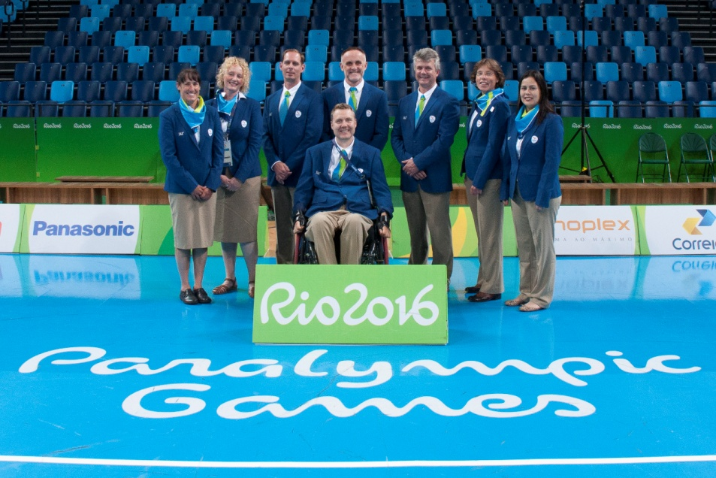
Level I National
Attend basic workshop
Sign Code of Conduct
Classifier Pathway
Basic knowledge of Wheelchair Rugby
Begin Logbook
WWR Funded from Level II up
Level II Zonal or International
Minimum 1 year experience
Perform complete athlete evaluation process
Level III International
Minimum 2 years experience
Know the eligibility requirements, MIC, Protest
Experience as Head Classifier
Level IV International
Teach advanced workshop
Ongoing leadership skills/activities
Notes:
Classifier Level Descriptions
WWR Classifier Handbook – 4. Classification Competencies, Training and Certification
Level 1
Comply with the WWR Code of Conduct.
Obtain and become familiar with the IWRF Classification Rules, the WWR Classifier Handbook, and accompanying documentation.
Attend an WWR basic workshop for entry-level education supervised by an WWR Level 3 or 4 classifier.
Demonstrate basic knowledge of wheelchair rugby.
Begin logbook documenting rugby experience and activities.
Level 2
Perform complete athlete evaluation process independently including physical, technical, and observation assessment, as appropriate to their professional qualifications.
Explains findings accurately to experienced WWR level 3 and 4 classifiers.
Give a basic explanation of athlete evaluation findings to the classification panel, athletes and appropriate athlete support personnel with an WWR classifier level 3 or 4 present.
Seek guidance and assistance when needed.
Demonstrate minimum of one year classifying with a national wheelchair rugby program, or zonal/regional developmental events or competitions, to be a candidate for level 2 certification.
If a classifier is inactive for a four-year period, the classifier may decrease in level of certification as recommended by the WWR.
Level 3
Performs the complete athlete evaluation process independently and provides a complete explanation of findings to the classification panel, athletes, and athlete support personel
Explain the procedures in athlete evaluation including eligibility requirements and Minimum Impairment Criteria, protest procedures, and the procedure following a Not Eligible decision to the classification panel, athlete, and athlete support personnel.
Attend an advanced workshop, supervised by WWR international classifier Level 3 or 4.
Instruct all or part of a basic workshop supervised by another WWR international classifier Level 3 or 4.
Deliver an advanced workshop supervised by another WWR international classifier level 3 or 4.
a. The advanced workshop may be one selected from the WWR website on a relevant topic and presented with modifications or revisions if appropriate.
b. This does not have to be an original workshop developed from the very beginning, but may use or be based on previous work.
c. Assistance and mentoring may be provided by another level 3 or level 4 classifier as requested.
Experience as Chief Classifier at a national, zone, or international Competition with a minimum of four teams participating.
Continuing participation as member of classification panel at national, zone and/or international level.
Demonstrate a minimum of two years of experience at a national, zone, and/or international classifier as an WWR Level 2 classifier to be considered for Level 3 certification.
If a classifier is inactive for a four-year period, the classifier may decrease in level of certification as recommended by the WWR.
Level 4
Demonstrate leadership skills and activities in matters related to classification, such as administration and management of classification; rules, policy and procedure development or revision, classification research, classification education and training, and classifier mentorship.
Develop and instruct an advanced training workshop supervised by a level 4 WWR classifier.
The topic may be selected independently by the classifier seeking advancement to level 4, or they may consult with a level 4 classifier mentor to decide upon a relevant topic for the upcoming event where the workshop will be presented.
Continuing participation in training and certification of classifiers, such as teaching and supervising/mentoring instructors at basic and advanced workshops.
Continuing participation as a member of classification panel at national, zone and international level.
If a classifier is inactive for a four-year period, the classifier may decrease in level of certification as recommended by the WWR.

Slide 11

Principles of Classification
Define who is eligible to compete in Para-sport and consequently who has the opportunity to reach the goal of being a Paralympic Athlete
Impairment type: biomechanical in wheelchair rugby
Evidence Based Sport-Specific Classification
(in process)
Compliant with 2015 IPC Athlete Classification Code and International Standards
Group athletes into sport classes that aim to ensure that the impact of impairment is minimized and sporting excellence determines which athletes or team is ultimately victorious
Notes:
Competition is one of the factors that distinguishes sport from recreation or exercise.
Competition is known to be a potent social factor that motivets many thousands of people to play sport.
When the competition is one-sided or predictable, motivation to participate in sport is reduced, particularly amongst the unsuccessful.
Classification in sport reduces the likelihood of one sided competition and in this way promotes participation.
There are two forms of classification:
Performance classification (like handicap in golf or first, second and third teams of soccer playing in different competitions)
Selective classification that minimises impact of certain factors (age, sex or weight) on competition.
Classification in wheelchair rugby and other Paralympic sports in restricted to selective classification.
Because it only takes into account the effect of impairments on sport specific performance and not other determinants like gender, training, talent, equipment, performance within one class can vary considerably!
IPC identified three impairment types that are eligible for paralympic sports:
Biomechanical impairments
Vision impairment
Intellectual impairment
Wheelchair rugby athletes are only classified for biomechanical impairments
In the IPC classification code that is applicable to wheelchair rugby it is stated that both the type and the severity of the impairment should be defined per sport, depending on sport specific activity limitation (for example, amputation is an eligible impairment for both athletics and swimming, however, amputation of one hand leads to considerable impairment in swimming, but not in long distance running. Therefore an athlete with an amputated hand is eligible for paralympic swimming, but not for paralympic athletics).
Last but not least, the relation between the units of impairment that are classified should be evidence based. At this time, none of the classification systems are evidence based. Wheelchair rugby is currently in the process of developing toward an evidence based classification system.

Slide 12
The following should NOT under any circumstances affect an athlete's class
in any sport
Principles of Classification
Sport skills or natural talent
Body size or type, i.e. height, strength, length or arms etc.
Gender
Genetics
Training effect
Use of equipment that provides stability and allows enhanced techniques/ performance
Notes:
All of these factors are not part of classification. The exception is gender. Gender does not impact on classification in itself, but to encourage female athletes to play wheelchair rugby, WWR has decided that if there is a female athlete on court, a line up can have 8.5 as total point value, instead of the normal 8.0 This is strictly a competion rule and not a classification rule. The athlete’s class stays the same.
In some tournaments this competion rule can even be different. In a tournament like Bernd Best in Germany, a team can add 1.0 to the maximum score for the team line up per female athlete.
In most individual sports men and women compete in a separate competition because of the impact of gender on maximum performance. However, this is not possible in wheelchair rugby untill today, because of the low number of female athletes.
Equipment is not part of classification in wheelchair rugby. The competion rules decide which equipment type and size is allowed. Within those rules, athletes can use any types of gloves, strappings and wheelchair set up they like. Some athletes are very clever in developing their own equipment that helps them to perform. If on court performance does not seem to match with function and activities observed in the first part of the bench test, classifiers should have an understanding of what is the role of equipment in the perfromance on court is. Athletes are usually very keen in showing there equipment and explaining what it does for their performance.

Slide 13

WWR Classification System
Evidence Based Sport-Specific Classification System (in process)
7 classes
0.5, 1.0, 1.5, 2.0, 2.5, 3.0, 3.5
Comprised of:
Physical Assessment (PA)
Technical Assessment (TA)
Observation Assessment (OA)
(Left Arm + Right Arm) / 2 + Trunk Value = Class
Sport Class Status
indicates whether or not an Athlete will be required to undertake Athlete Evaluation in the future; and if the Athlete’s Sport Class may be subject to Protest.
N, R, C, FRD

Slide 14
Eligible Impairment Types for Wheelchair Rugby
Impaired Muscle Power
Limb Deficiency
Impaired Passive Range of Movement
Hypertonia
Ataxia
Athetosis
Notes:
In our classification system, we currently measure impaired strength and limb length deficiencies.
In the remarks we can add impairments in passive ROM. This does have a defined profile in the trunk tests (as part of test 3,4 and 5 where both active and passive range count for the result of the test), but it does not have a defined profile in the arm and hand classes.
Also, impairments in coordination do not have a dedicated test procedure and defined profile.
For range and coordination impairments we watch the impact in sport specific activities and on court performance. This is not ideal, but a reliable and valid test for measuring these impairments is not available at this moment. Expert opinion is the best option at this moment. Development of tests to test these impairments and validate them for their impact on performance will be subject of future development.

Slide 15
Underlying Health Condition eligible for Wheelchair Rugby
Spinal Cord Injury
Muscular Dystrophy
Cerebral Palsy
Amputation
Congenital Limb Deficiency
Other health conditions
Polyneuropathy
Arthrogryphosis
Post-Polio Syndrome
Traumatic brain injury
Multiple Sclerosis

Slide 16
Non-eligible Impairment Types for Wheelchair Rugby, but eligible for other Para-sports
Leg Length Difference
Short Stature
Vision Impairment
Intellectual Impairment

Slide 17
Non-eligible Impairment Types for ALL Para-Sports
Pain
Hearing Impairment
Low muscle tone
Hypermobility of joints
Joints instability (unstable joint, dislocation)
Impaired muscle endurance
Impaired motor reflex functions
Impaired cardiovascular functions
Impaired respiratory functions
Impairment metabolic functions
Tics and mannerisms, stereotypes and motor perseveration

Slide 18


Medical Diagnostic Information is required for every athlete in order to confirm that the athlete has a permanent, verifiable health condition that results in an eligible impairment as defined by the WWR
Medical Diagnostic Form must be completed in English by a registered medical doctor
Medical Documentation must be in English OR accompanied by a verified English translation
Medical Diagnostic Form + Medical Documentation must be provided to WWR HoC a minimum 6 weeks prior to event
Eligibility Assessment Committee may be appointed to review Medical Diagnostic Information
Medical Diagnostic Information

Slide 19
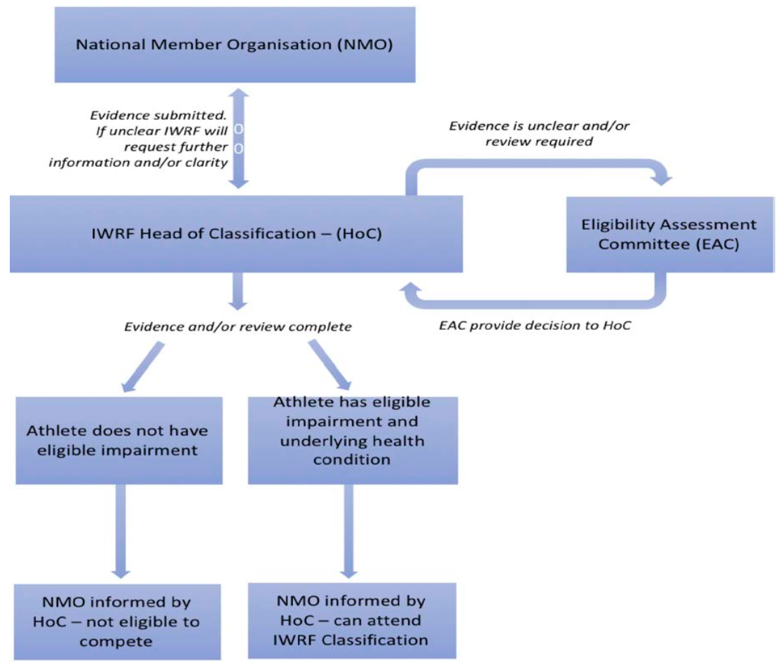
Assessment of Eligible Imapriment

Slide 20
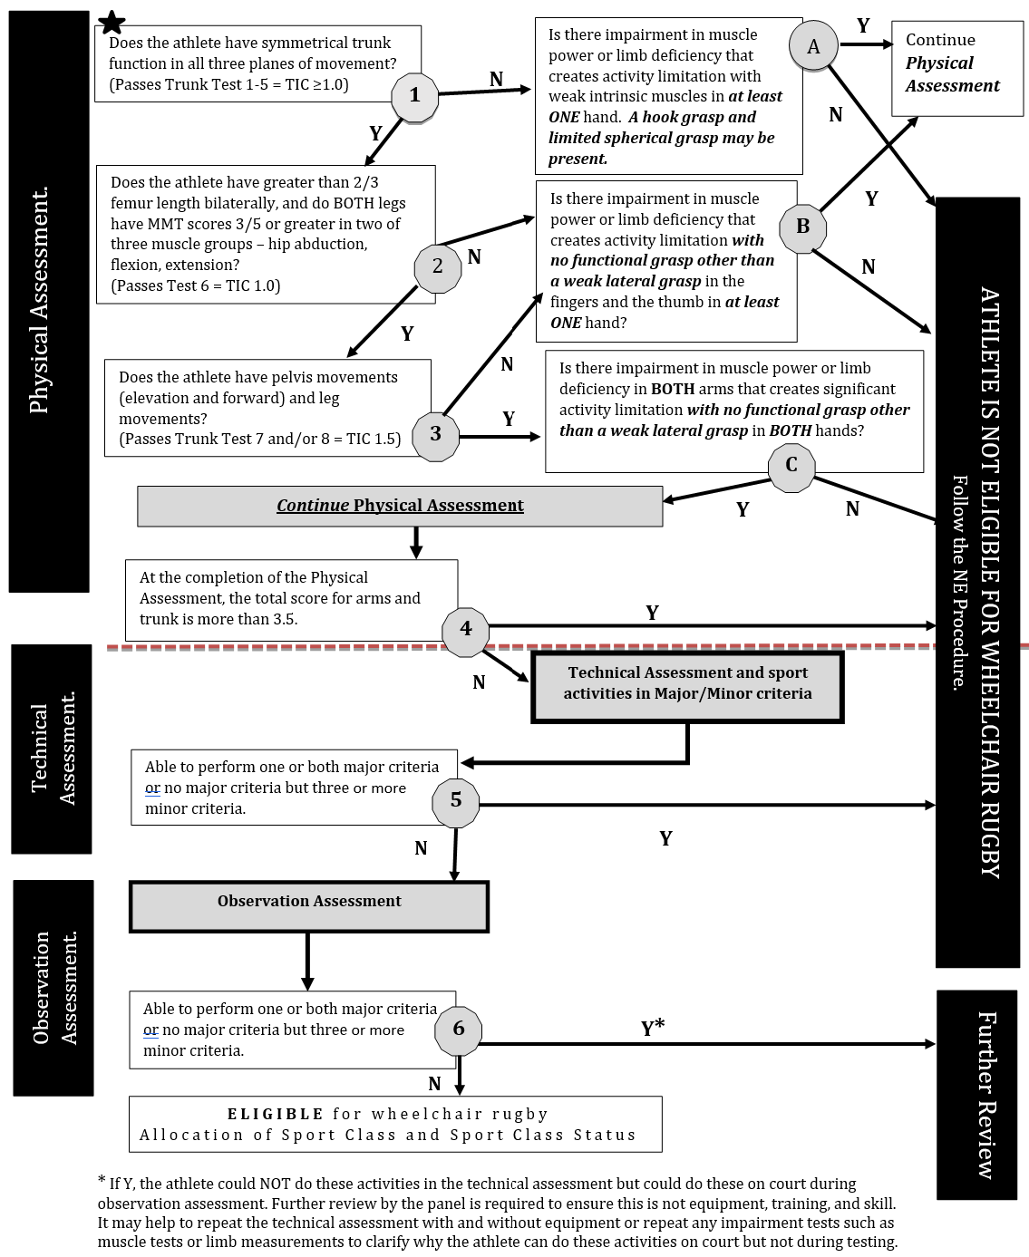
Minimum Impairment Criteria and Athlete Evaluation
Notes:
MIC Flow Chart has to be changed after Tokio, after 1st of October 2021.

Slide 21

*
If Y, the athlete could not do these activities in the Technical Assessment but could do these on court during Observation Assessment.
It may help to repeat the Technical Assessment with and without equipment, or repeat any impairment tests such as muscle tests or limb measurements to clarify why the athlete can do these activities on court but not during testing.
Further review by the panel is required to ensure this is not equipment, training and skill.
Minimum Impairment Criteria and Athlete Evaluation

Slide 22
Combination of UE & Trunk Scores can not be more than 3.5
In cases of borderline eligibility or if the athlete has an impariment for which minimum impairment criteria is not yet established, Major & Minor Criteria are used to decide if the athlete is not eligible or if the athlete proceeds to OA.
Trunk Test (TIC),
Manual Muscle Testing (MMT),
Limb Length Measurement
Passive Range of Movement (PROM),
Coordination Tests
Athlete Evaluation

Slide 23

Eligible Athlete
An athlete must have Eligible Impairment Type and Underlying Health Condition,
AND
An athlete must meet Minimum Impairment Criteria to proceed through Athlete Evaluation,
AND
Following Athlete Evaluation, an athlete must be allocated one of 7 sport classes (0.5 – 3.5)

Slide 24

Not eligible Athlete – NE
„Big” NE = an athlete does not have eligible impariment type and underlying health condition = NE C
(no protest, no re-Classification)
„Little” NE = an athlete has eligible impairment type but does not meet Minimum Impairment Criteria (MIC) = an athlete allocated more than 3.5 = not eligible for Wheelchair Rugby = NE R
(no protest, but re-Classification by the 2nd panel)
If an Athlete allocated NE by second panel = NE C
(no protest, no more re-Classification)

Slide 25
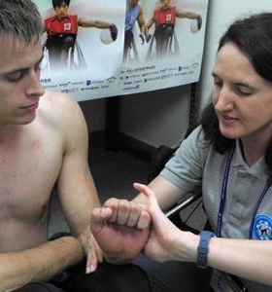
Physical Assessment
Trunk Test (TIC)
8 Tests
Based on trunk and leg muscle power, range, leg length and coordination
Manual Muscle Testing (MMT)
Shoulders: Deltoids, Serratus anterior, Pectoralis (sternal, clavicular), Latissimus dorsi, Rotators (external, internal)
Elbows: biceps, triceps
Hands: wrists, fingers, thumbs
Passive Range of Movement (PROM)
Goniometer
Limb Length Measurement
Segmometer, stadiometer
Coordination Tests

Slide 26
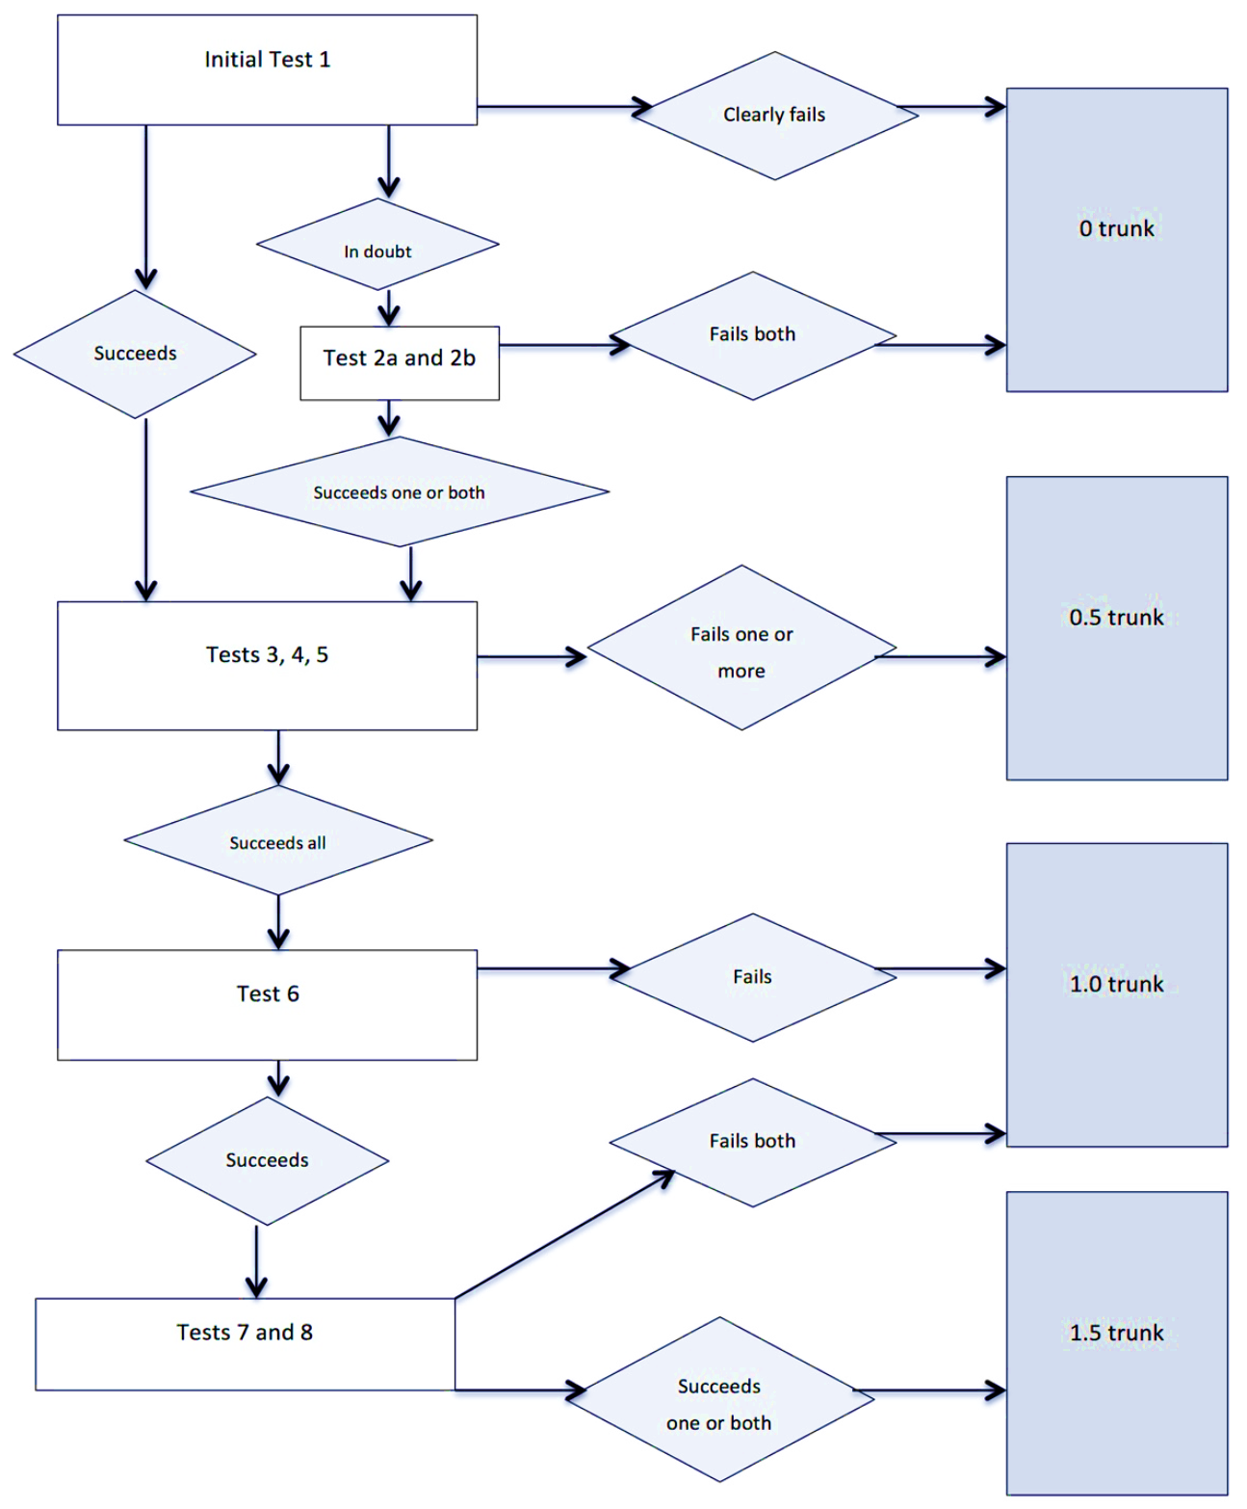
Trunk Tests
The trunk impairment consists of 8 tests, arranged in an algorithm
Not all trunk tests need to be done in all athletes
The highest test passed is decisive for the trunk value in the entry sport class
Trunk movement, control and stability have an impact on wheelchair and ball activities
Notes:
26
To prevent extensive testing of athletes with complete impairment in the trunk, we developed a set of 8 tests of increasing difficulty. The tests are arranged in an algorithm as shown on the slide. After failure of one or more tests, the evaluation of trunk impairment ends and other tests do not need to be done. For example, in the first test the athlete needs to sit fully upright and unsupported. If the athlete fails to perform, or can only perform this test with compensations (support of arms, or maximum spinal lordosis or kyphosis) the evaluation of trunk ends and the other seven tests do not need to be done.
Adequate stabilisation of the pelvis by Classifiers is essential for tests 3,4 and 5. Adequate stabilisation of the pelvis should be achieved through fixating both of the athlete’s legs to the plinth, with the classifier’s hands on the proximal one third of the thighs, close to the hips. This may require one or two Classifiers. Failure to stabilize adequately may result in an inaccurate trunk score.
If an Athlete fails a test, this result must be consistent with the Athlete’s health condition/impairment. For example, Athletes who have limb deficiency, and no other identified health condition/impairment, should not fail tests 3, 4 or 5. If these Athletes fail one of these tests, then a valid reason for this must be identified. Repeated testing by Classifiers may be required while ensuring adequate stabilisation.
If Classifiers are unable to identify a valid reason for an Athlete failing a specific trunk test, based on the health condition/impairment type identified, then a trunk score cannot be allocated. This means that an WWR sport class cannot be allocated until the Athlete can present medical diagnostic information that provides evidence of an additional eligible health condition/impairment type that explains the results of the
trunk testing.
Technical assessment and observation assessment must also be consistent with the trunk score allocated.

Slide 27
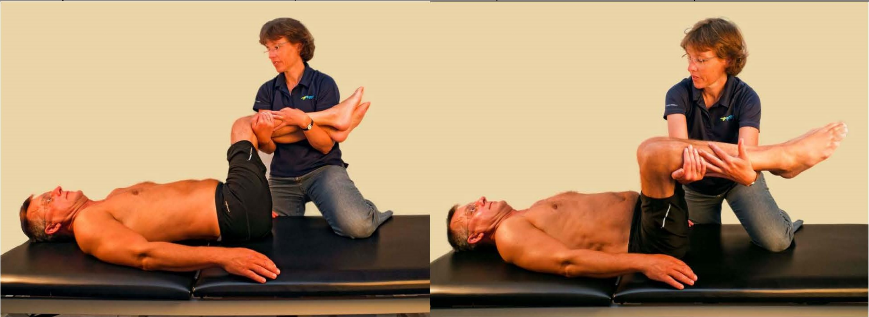
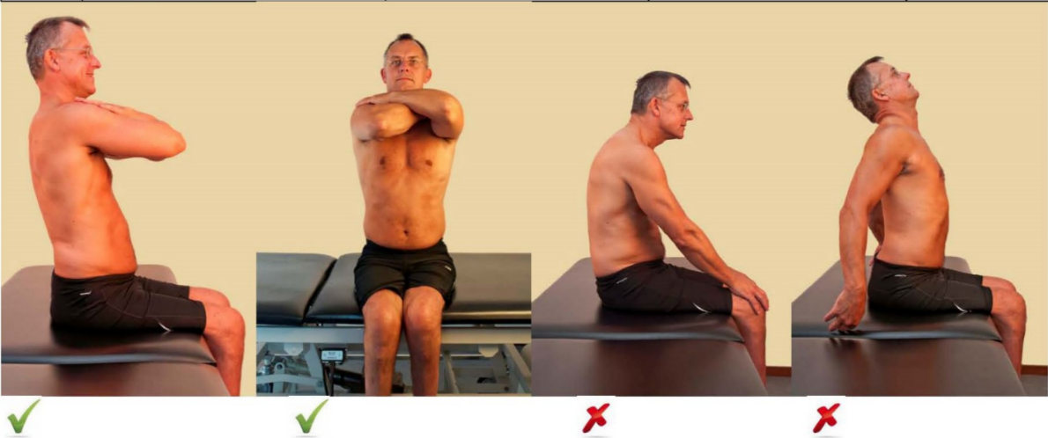
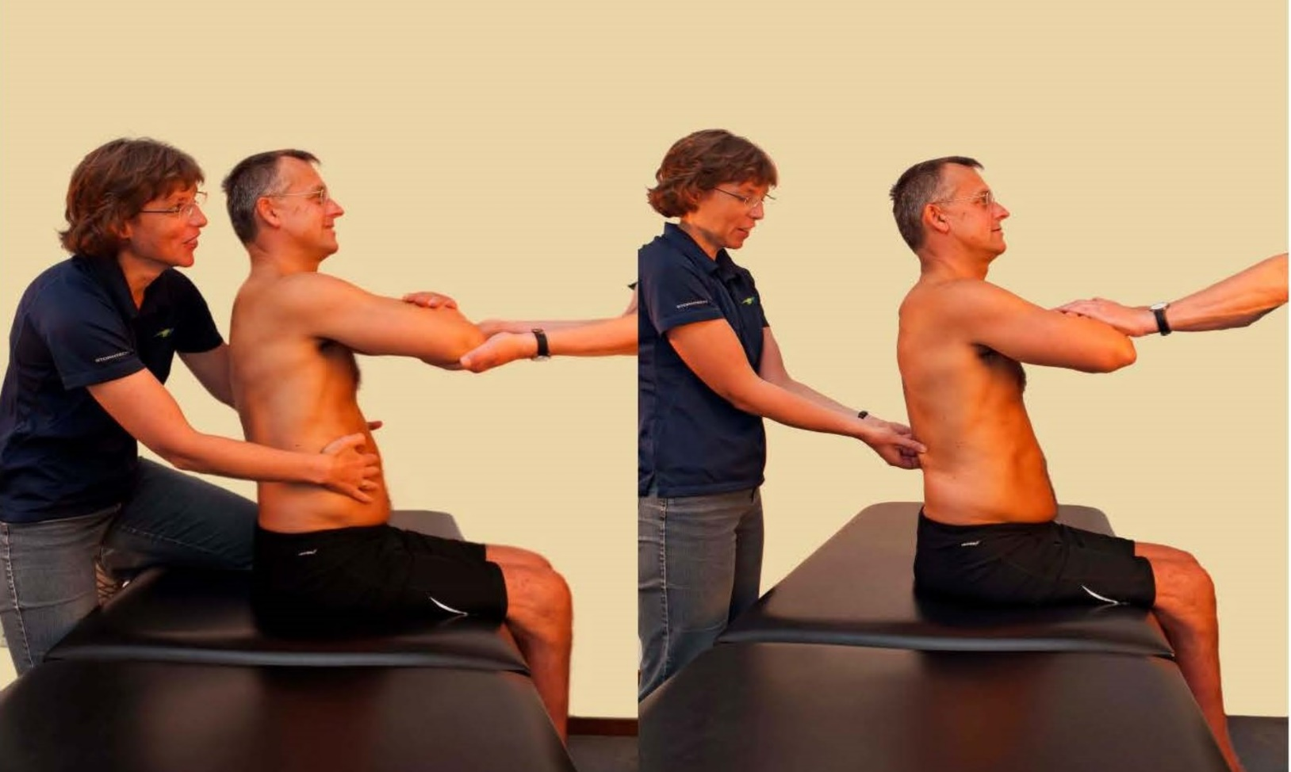
2a
1
2b

Slide 28
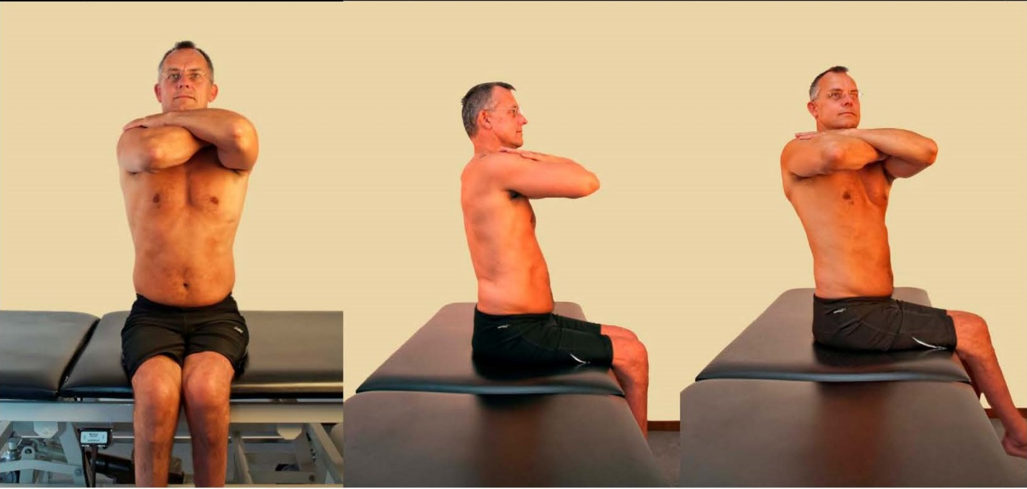
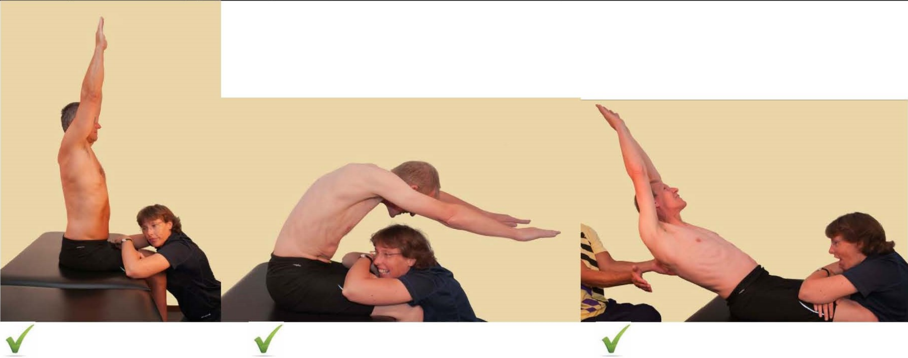
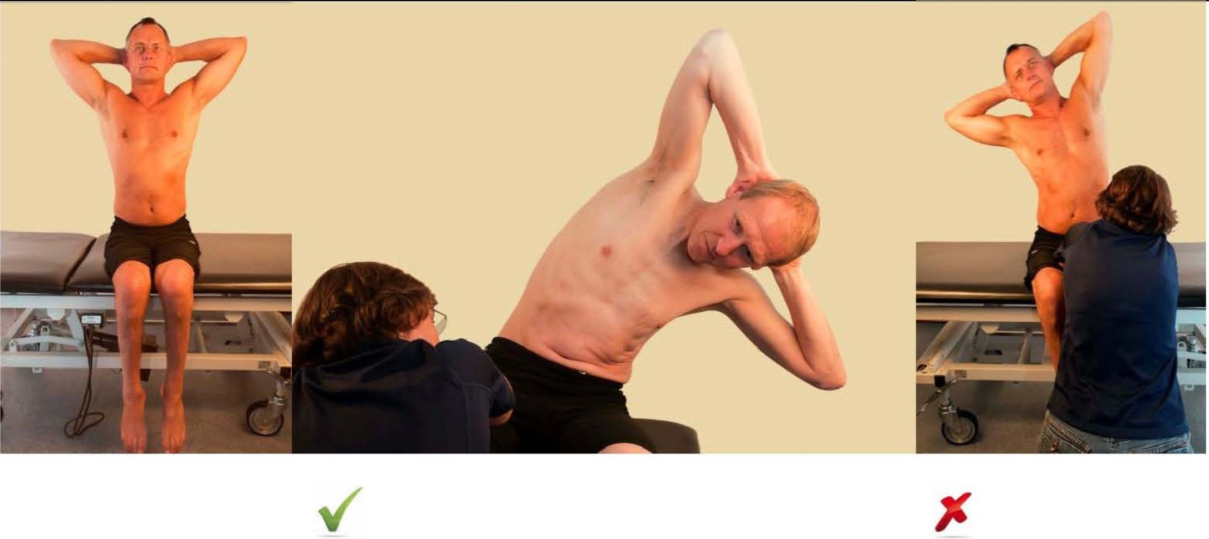
4
3
5

Slide 29
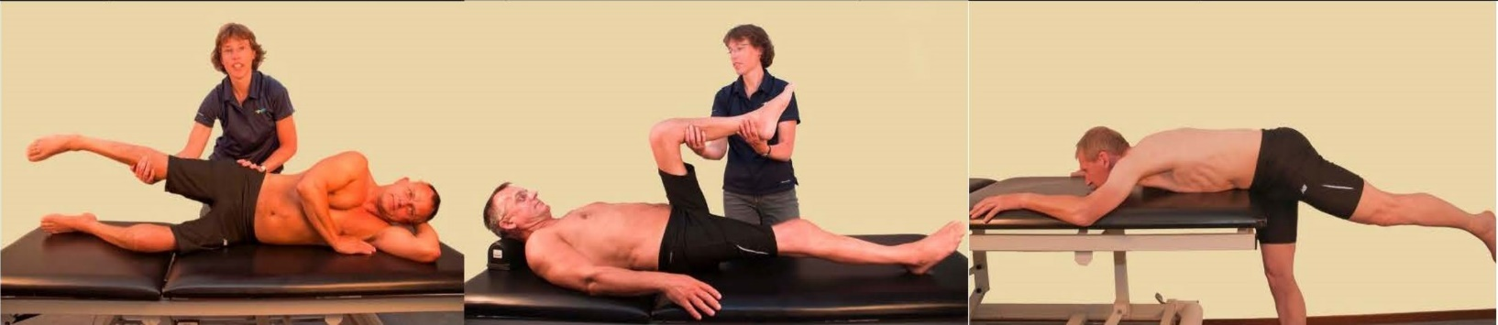
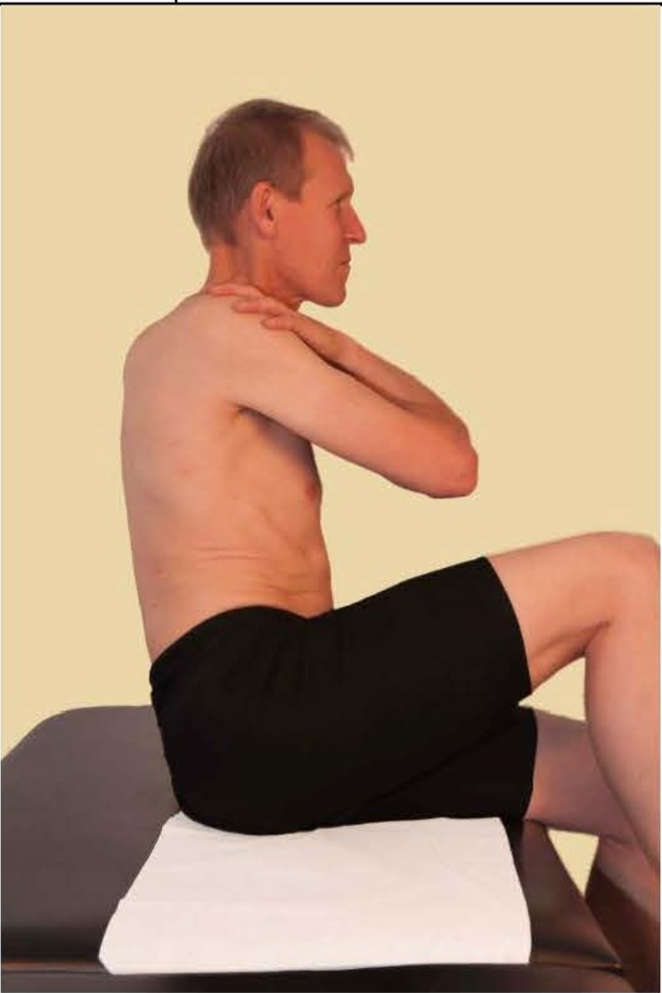
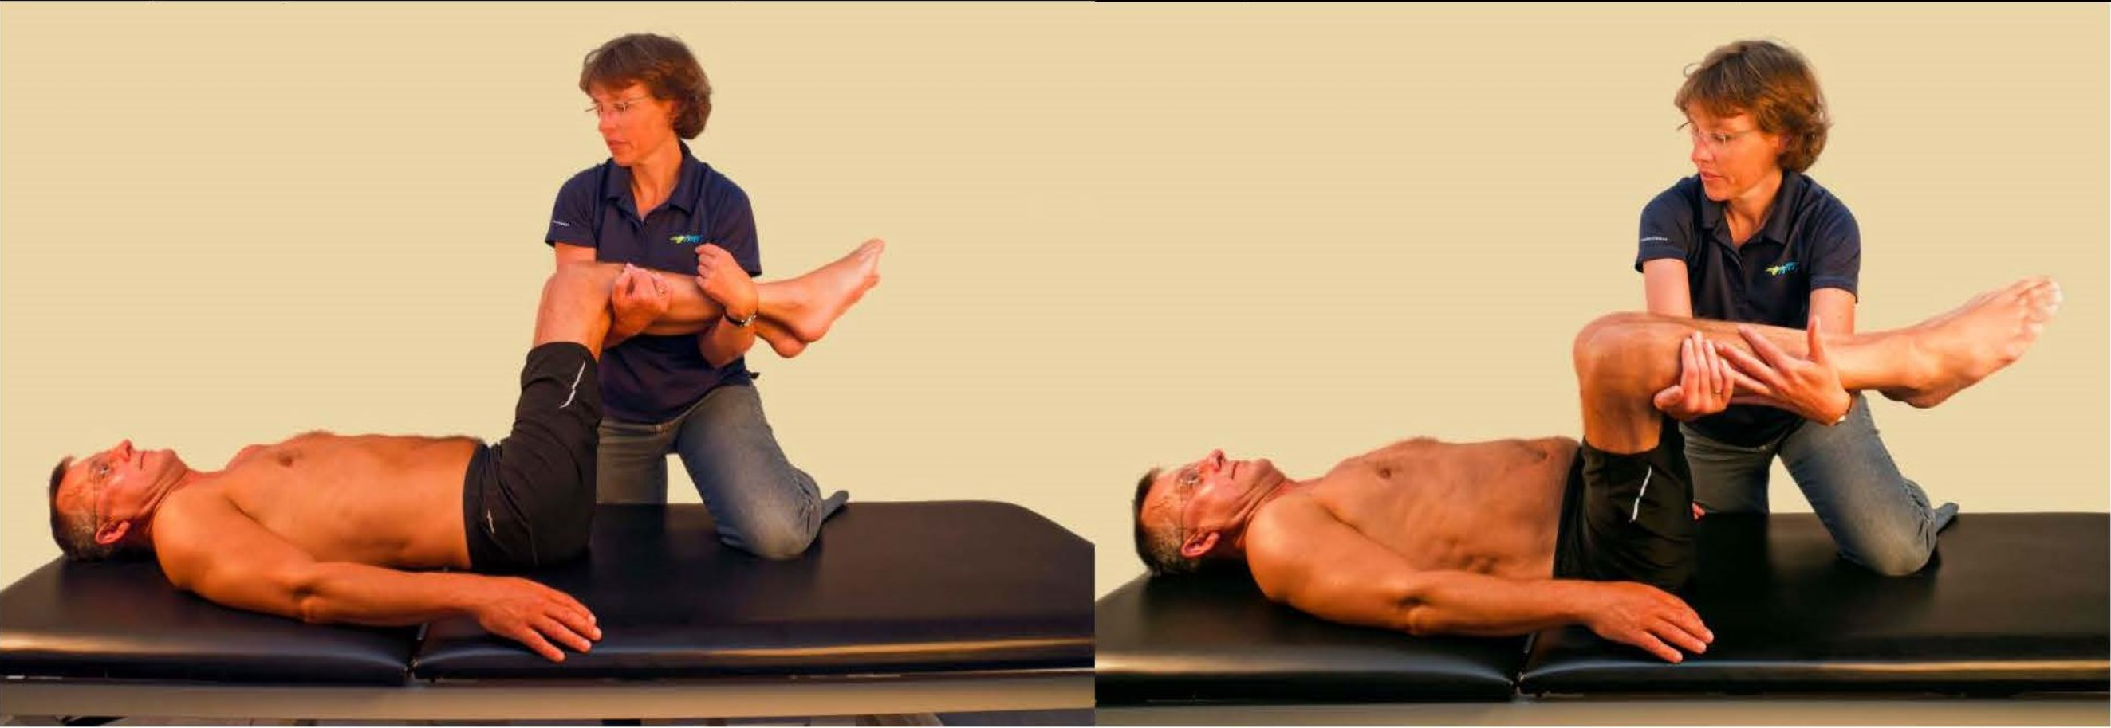
6
8
7

Slide 30
Manual Muscle Testing (MMT)
Daniels and Worthingham – muscle testing techniques and scoring criteria used in WWR
Some modifications in the testing positions and grading are made for sport specific testing for WWR (triceps, latissimus, sternal pectoralis, serratus anterior, shoulder rotators)
Grading is on a five-point ordinal scale

Slide 31
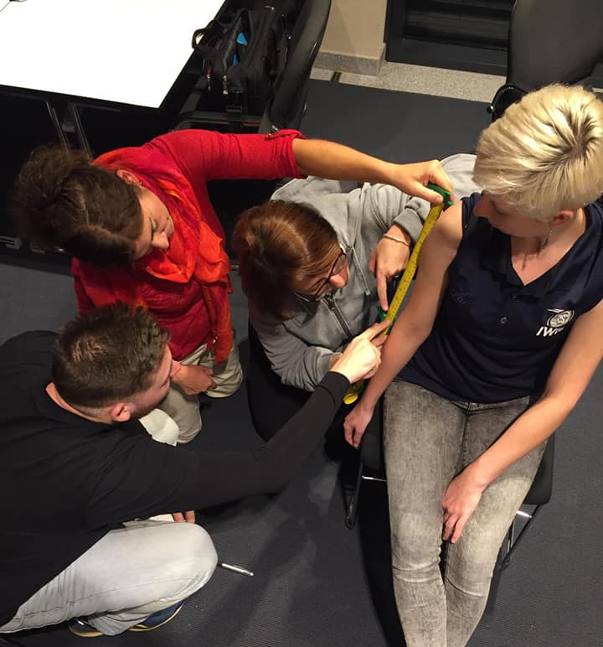
Limb length measurement
Specific impairment measures in the WWR classification system for limb deficiency to determine sport class is in a separated workshop.

Slide 32
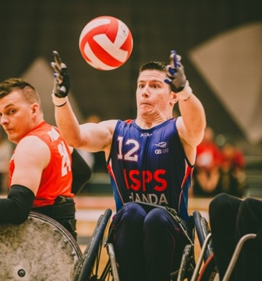
Coordination Tests
Specific impairment measures in the WWR classification system for hypertonia, ataxia, and athetosis to determine minimum impairment criteria and sport class are under development.

Slide 33
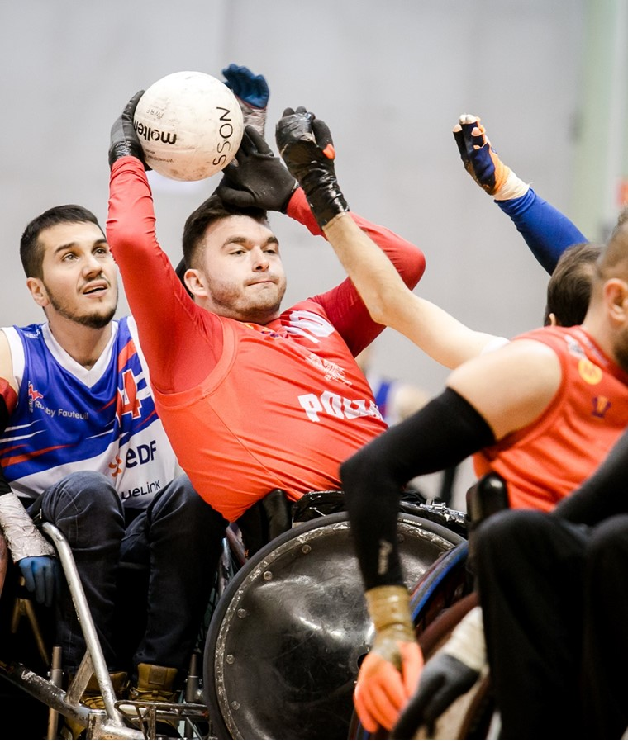
Passive Range of Movement measurement
Specific impairment measures in the WWR classification system for passive range of movement to determine minimum impairment criteria and sport class are under development.
Athletes with impairment in passive range of movement may be eligible in World Wheelchair Rugby, if the athlete has another eligible impairment due to an underlying health condition, which meets minimum impairment criteria for that eligible impairment.
Notes:
Usually athletes with impairment in PROM have also muscle power impairment.

Slide 34
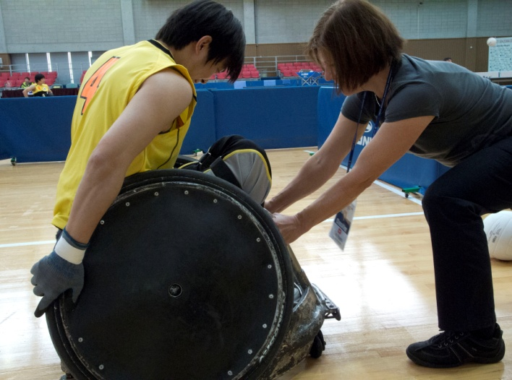
Technical Assessment
The Classifiers evaluate novel tests and sport specific tests in a non-competitive environment.
Novel tests and sport-specific activities are observed in the TA both with and without equipment to look at how an athlete does the activity and to consider the influence of equipment on wheelchair and ball handling.
The classifiers must be confident that an athlete has to performer the specific activities to the best of his/her ability during the TA and may request greater to ensure optimal observation opportunities.

Slide 35
Technical Assessment
Observation Assessment
Wheelchair Activities
Forward Propulsion
Ball Activities
Passing
Effect of Trunk on Chair and Ball Activities
Propulsion/ Maneuverability
Backward Propulsion
Maneuverability and Turning
Braking/ Holding
Catching
Dribbling
Picking up Ball
Braking/ Holding
Hits/ Trackles
Hopping the Chair
Reaching the Ball
Securing the Ball

Slide 36
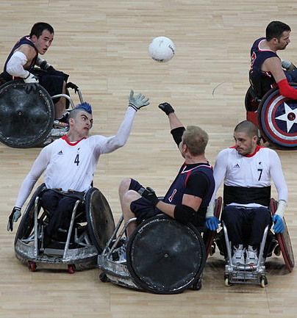
Observation Assessment
Tracking Code OA
An athlete, who is required to complete Observation Assessment will be designated with Tracking Code OA.
First Appearance
Observation in Competition Assessment must take place during First Appearance
First Appearance is the first time an athlete competes in a Competition in a particular Sport Class;
During the preliminary rounds or at the end of pool play
To zdjęcie, autor: Nieznany autor, licencja: CC BY

Slide 37
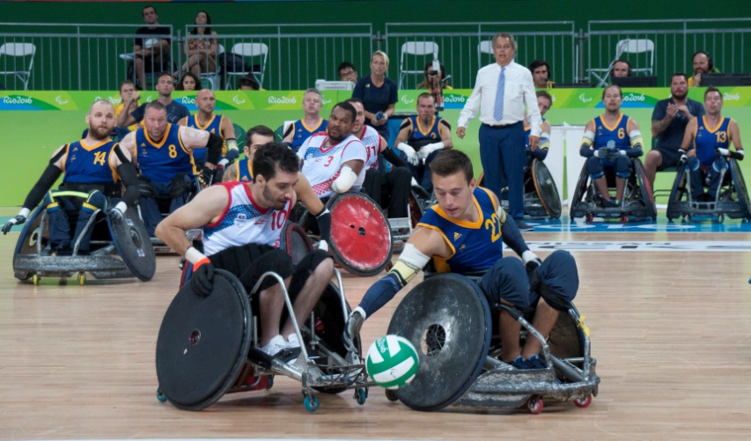
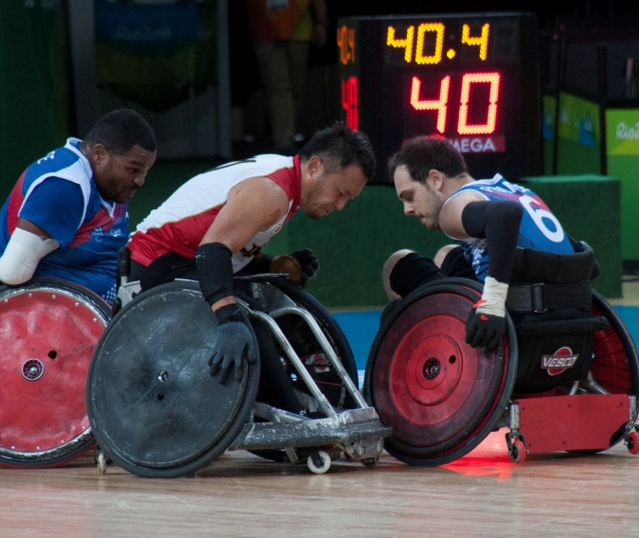
Class Profiles
  Low Pointers: 0.5
  1.0
  1.5
  Mid Pointers: 2.0
  2.5
  High Pointers: 3.0
  3.5

Slide 38
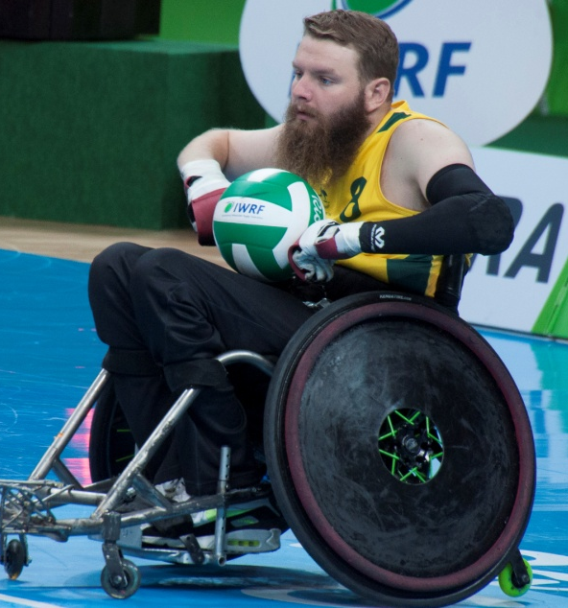
Class 0.5
Proximal weakness, no triceps, abducted elbows (muscle power impairment)
Slow acceleration & uni-directional maneuvering
„head-bob” when pushing
Flip pass and underhand volleyball pass
„Blocker”, defensive chair
Notes:
The 0.5 athlete classically presents with proximal weakness (shoulder girdle, shoulder rotation, sternal and clavicular pectoralis major) and no triceps. Functionally, they move their chairs with elbows abducted and with limited wheel contact (1/4 of wheel).
Athletes only with limb deficiency are practically not able to get this class due to active trunk muscles (minimum 0.5 TIC) and arms (minimum 0.5) to be able to push a chair.

Slide 39
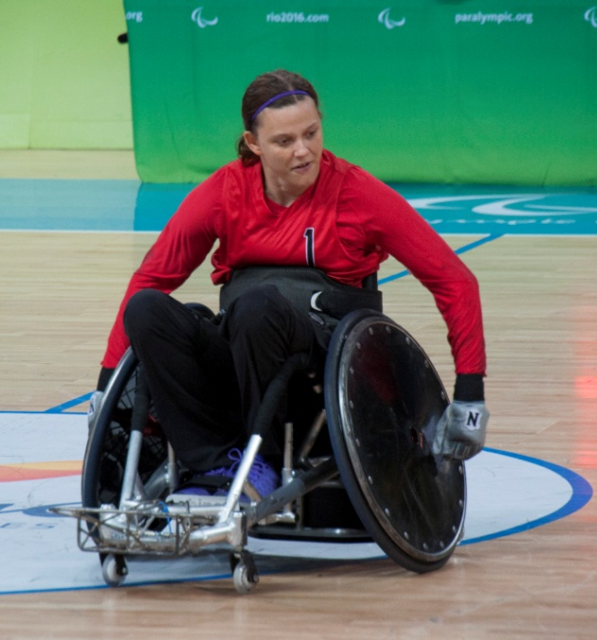
Class 1.0
Still proximal weakness, limited triceps (muscle power impairment)
Above elbow amputation with TIC (Limb deficiency)
Longer wheel contact when pushing with elbows in closer to the body
Better turning ability – multi-directional maneuvering
Less of „head-bob” when pushing
Flip pass and underhand volleyball pass
„Blocker”, In-bounder, defensive chair
Notes:
The 1.0 athlete presents with overall stronger muscles proximally (normal clavicular pectoralis but remaining weakness in sternal pecs, shoulders), a more “balanced” shoulder and may have limited triceps function (0-3 MMT grades) – athletes with muscle power impairment.
The 1.0 player has longer wheel contact, with elbows in closer to the athlete’s body (will appear more abducted than the 1.5 or 2.0 player, but less abducted than the 0.5 player).
Athletes with limb deficiency may have both arms 0.5 (amputation above elbows) and 0.5 TIC.

Slide 40
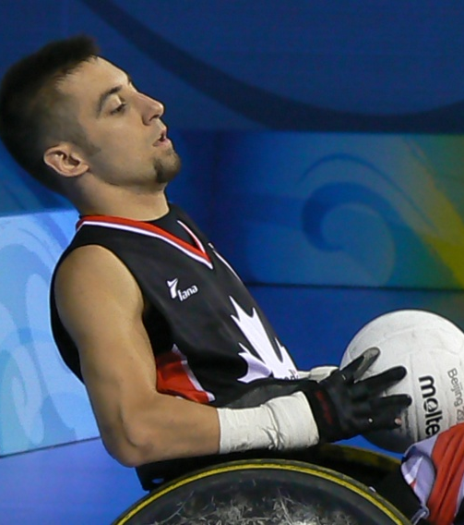
Class 1.5
Bilateral 1.5 arms OR assymetrical arms OR combination with trunk
Still proximal weakness, bilateral triceps 3+/4-, no TIC OR asymmetrical upper extremities, (muscle power impairment)
Around elbows amputation with TIC (Limb deficiency)
Good acceleration
Good chair turning ability, multi-directional maneuvering
Fair chest pass
In-bounder/ ball carrier, defensive chair
Notes:
The 1.5 class was created for those players who fall between the 1.0 and 2.0 classes, or those players with stronger but not normal triceps bilaterally. These players may have a small amount of proximal weakness (for example, serratus anterior).
This class was first developed for those players with asymmetry but has been expanded to include players with symmetrical triceps weakness.
One functional test that helps distinguish between the 1.0, 1.5 and 2.0 players is the “pop up” pass. The 1.0 athlete is typically unable to perform this due to lack of triceps and proximal weakness. The 1.5 player is able to perform this for limited height, but can complete the test due to better triceps and proximal shoulder/chest strength. The 2.0 player performs this test with the greatest height.
Athletes with limb deficiency:
both arms 0.5 and TIC 1.0,
both arms 1.0 and TIC 0.5,
One arm 0.5, second arm 1.0, TIC 0.5.

Slide 41
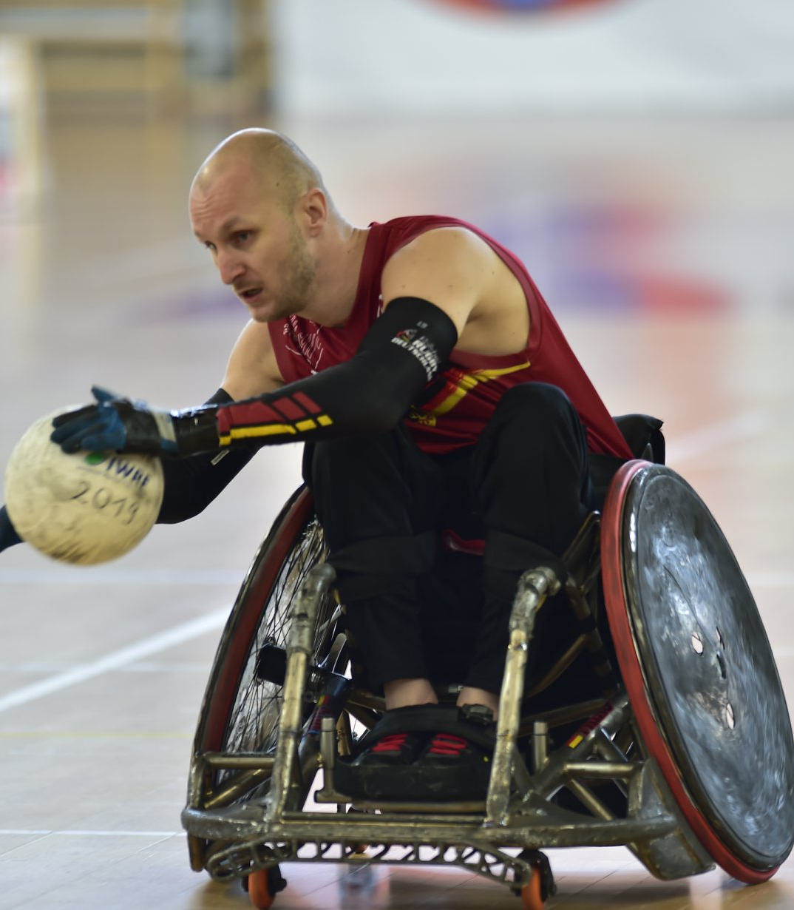
Class 2.0
Bilateral 2.0 arms OR asymmetrical arms OR combination with trunk
Strong shoulder girdle, strong triceps, balanced wrist flex/ext, no TIC (muscle power impairment)
Above elbow amputation or below elbow amputation with TIC (Limb deficiency)
No/ little hand function
Excellent chair skills
Strong chest pass, overhead two handed pass
Poor one handed pass
Strong when picking
Good ball security
Ball carrier
Notes:
The 2.0 athlete presents with more normal triceps function on court (good to normal triceps manual muscle test grades), and more balanced wrist function (extension and flexion). These athletes have an effective chest pass.
Athletes can have weaker arms if trunk muscle are present. The combination of UE and TIC: 1.5 arms and 0.5 TIC, 1.0 arms and 1.0 TIC or asymmetrical arms and trunk.
Athletes with limb deficiency may have amputation around elbows (1.0) while stronger trunk (1.0) or amputation below elbows greater than ½ of forearm (1.5 arms) with weaker trunk (0.5).

Slide 42
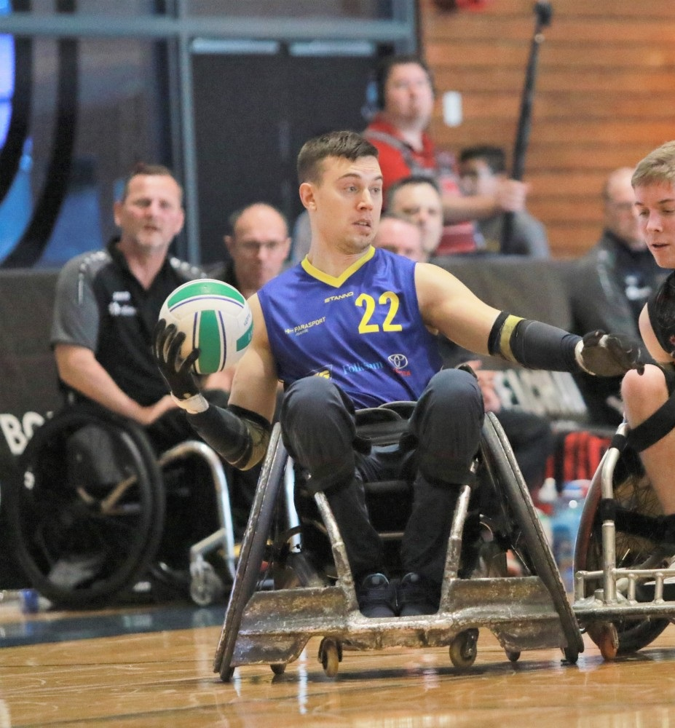
Class 2.5
Bilateral 2.5 hands OR asymmetrical hands OR combination with trunk
Strong wrist, balanced fingers flex/ext without true grasp-release (muscle power impairment)
Below elbow or around palm amputation with TIC (limb deficiency)
Excellent chair skills
Strong chest pass, overhead pass
Good one handed pass (lacks accuracy & consistency)
Good ball security
Ball carrier
Notes:
The 2.5 class was created to handle those players who fall between the 2.0 and 3.0 classes. The class was historically composed of players with asymmetry. However, the class now includes athletes with limited hand function bilaterally.
These players demonstrated a “curling and uncurling” of the hand and not functional “grasp and release” seen with athlete with the 3.0 hand. This curling/uncurling motion results due to the action of the Flexor Digitorum Superficialis (FDS) and the Flexor Digitorum Profundus muscles (FDP) without the stabilizing effect of functional intrinsic muscles.
Consequently, the athlete with the 2.5 hand will have marked intrinsic wasting, including the thenar and hypothenar eminences, and little to no maintenance of the hand arches.
Reasonably balanced finger flexion and extension without true grasp and release
Functional grip that may be seen when challenged
Utilizes wrist position to strengthen grip and release, but may perform some grip and release independent of wrist position
Dribbles safely, but still uses forearm scoop to lap for ball safety. May be able to catch with two hands, usually scooping ball to lap. May catch pass single handed and scoop to chest or lap.
Improved ball security when compared to 2.0 player due to improved ability to isolate wrist/finger function.
Asymmetrical athletes may have weaker arms with stronger trunk.
Athletes with limb deficiency may have amputation below elbows (1.5) with stronger trunk (1.0), around elbow amputation (1.0) with stronger trunk (1.5) OR amputation around palm (2.0 hands) with weaker trunk (0.5).

Slide 43
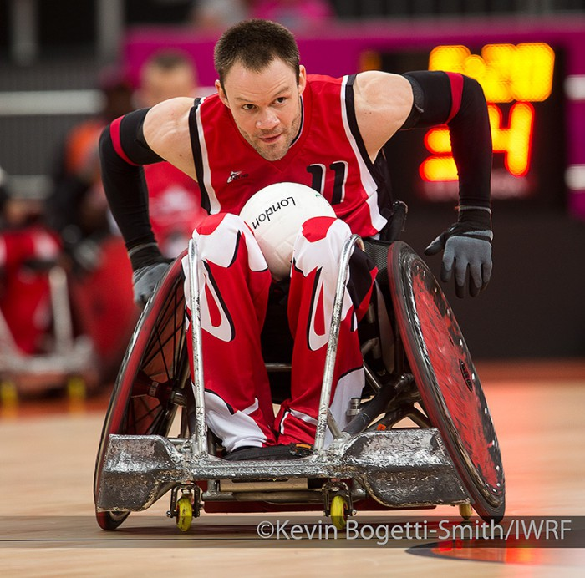
Class 3.0
Bilateral 3.0 hands OR asymmetrical arms OR combination with trunk
No/ limited intrinsic hand muscles (muscle power imapriment)
Amputation around hand/ fingers with TIC (limb deficiency)
Functional grasp & release
Limited thumb function
Excellent chair skills
Strong chest pass, overhead pass
Very good one handed pass
Good multi-dribbling
Excellent ball security & control
No.1/ No.2 ball carrier
Notes:
The 3.0 athlete presents with functional grasp and release and significant hand function (athlete: Fabien Lavoie Canada). Uses wrist/finger flexion in flip pass, rimming ball, stabilising with opposite arm to allow for greater reach.
Multiple dribble one-handed, with control.
Functional finger flexion and extension allows for control of the ball in varying planes.
However, if the athlete does have some trunk function, the hand function will be less.
Athletes with limb deficiency may have amputation around hand (2.0 arms) with stronger trunk (1.0), or amputation above wrist (1.5) with stronger trunk (1.5TIC), or amputation around fingers (2.5 hands) with weaker trunk (0.5 TIC).

Slide 44
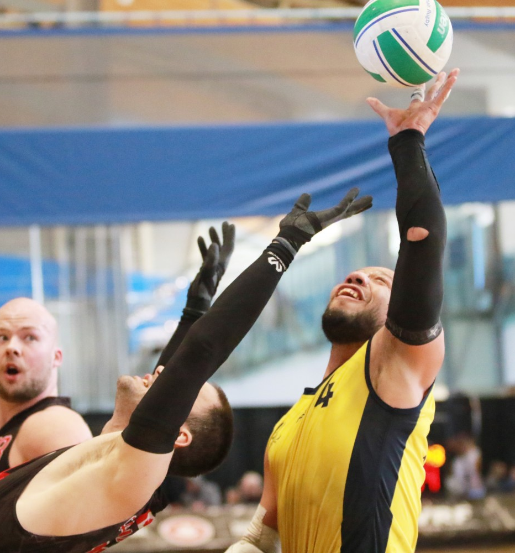
Class 3.5
Combination with trunk
NO possible to have both arms 3.5
Excellent chair skills
Excellent passing skills
Excellent ball security & control
No.1 ball carrier
Notes:
The 3.5 class typically includes the highest functioning athletes, or those athletes with the potential for the greatest amount of function. These players may possess significant hand function and/or trunk function.
Note that any class (with the exception of the 0.5 class player, may have trunk function, that is added to the arm function point value giving the athlete his/her final class).

Slide 45
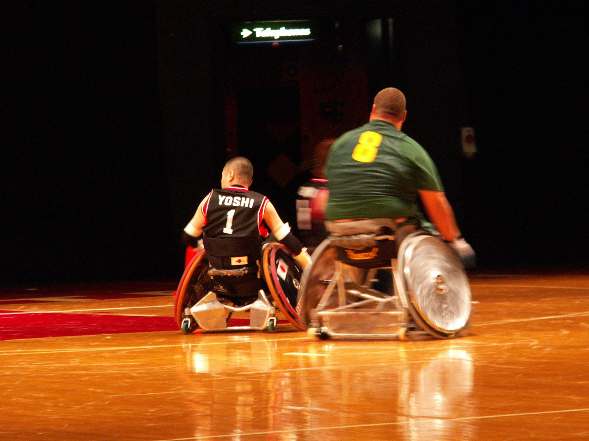
The Difference between…...1.0 & 2.5
Japan 1.0, South Africa 2.5. Body height, training, talent and so on should not influence the athlete’s class
Notes:
Player on left is Yoshinobu Takahashi (Japan) 1.0
Player on right is Luan Degenaar (South Africa) 2.5
This underlines that anything else than function is no part of classification. Body height, training, talent and so on should not influence the athlete’s class.

Slide 46
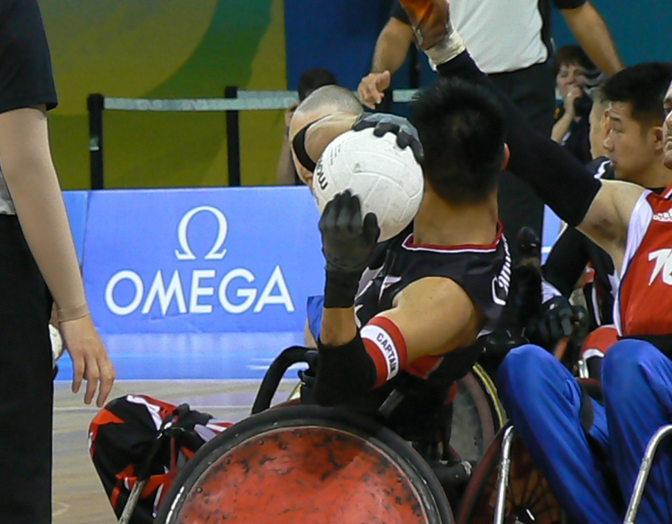
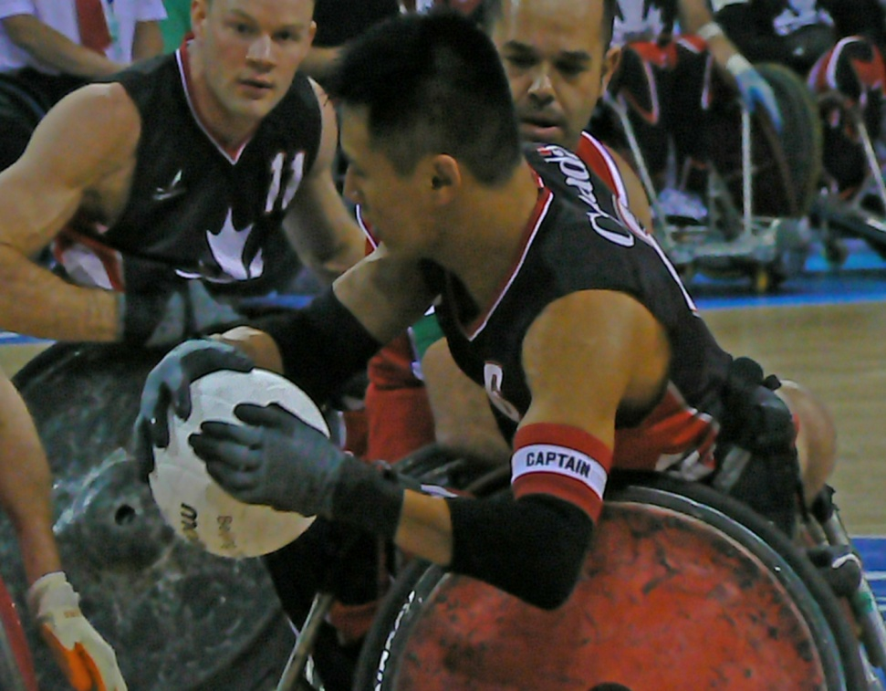
Hand with and without impairment in muscle strength
Left arm 2.0, right arm 3.5.
Notes:
Canadian player Ian Chan, who has a normal hand on the right and impaiment in muscle power in the left hand consistent with a 2.0 hand due to brachial plexus injury on that side.

Slide 47
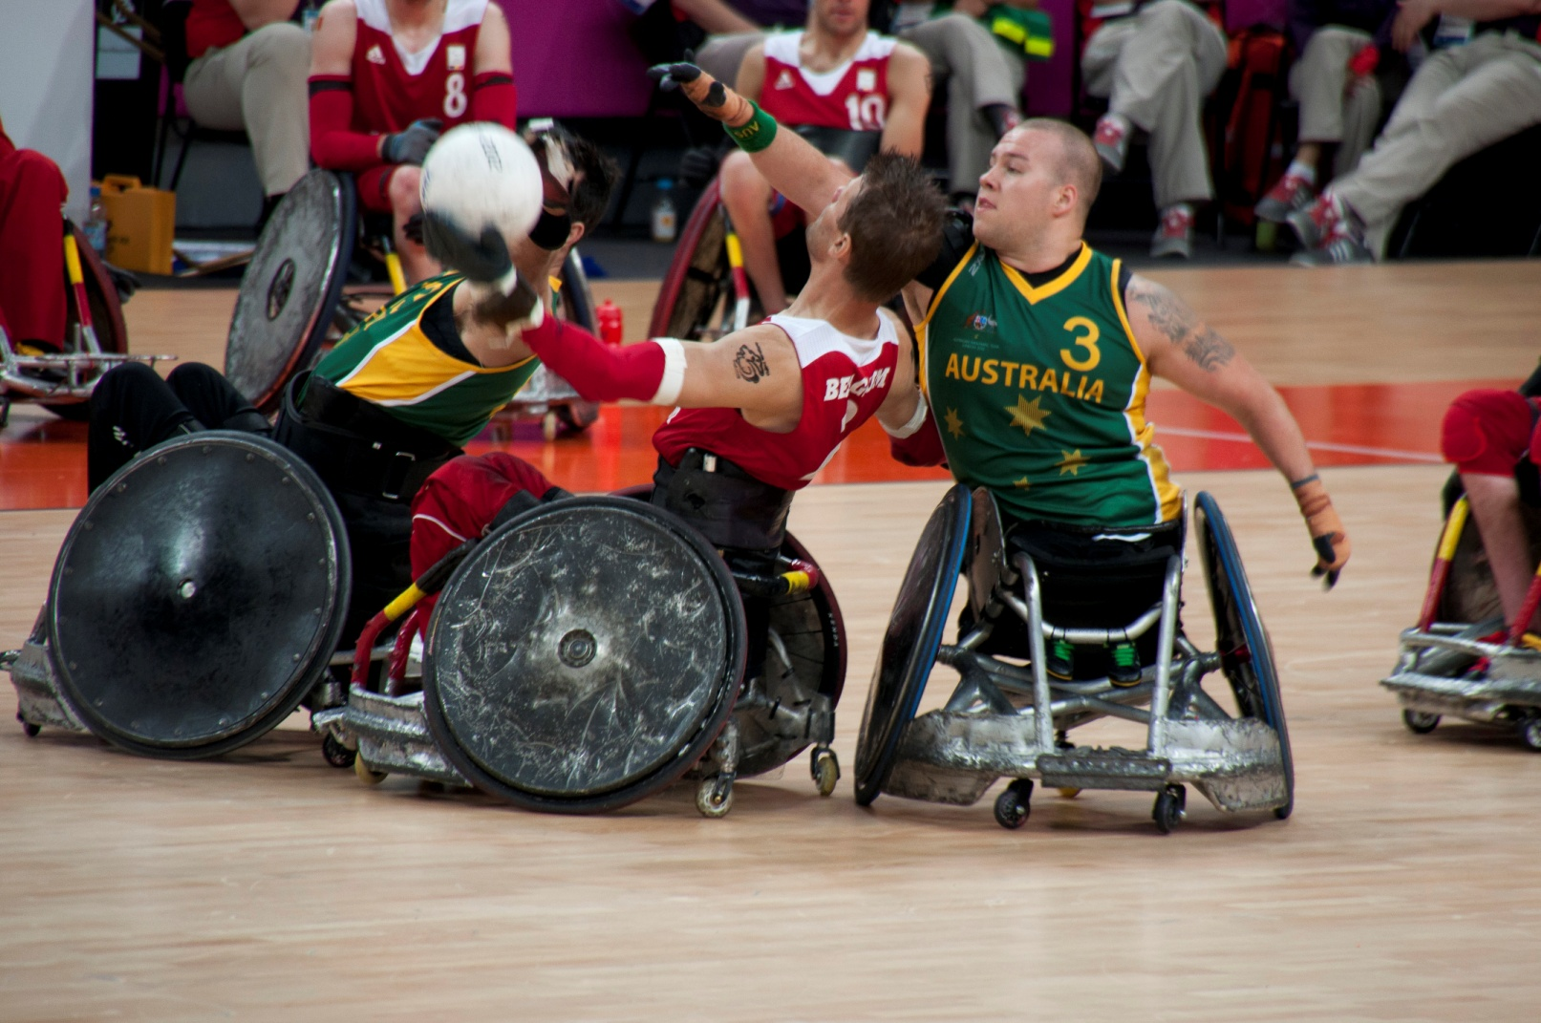
Player with full trunk impairment and player with limited trunk impairment
Athlete with red jersey – 0 Trunk, Athlete with green jersey– 1.0 Trunk
Notes:
Ryley Batt Australia 1.0 trunk and Peter Genijn Belgium 0 trunk
Watch trunk postion and backrest height and strapping. Also watch arm position or Ryley for counter balance, needed for short leg length and limitations in base of support.

Slide 48
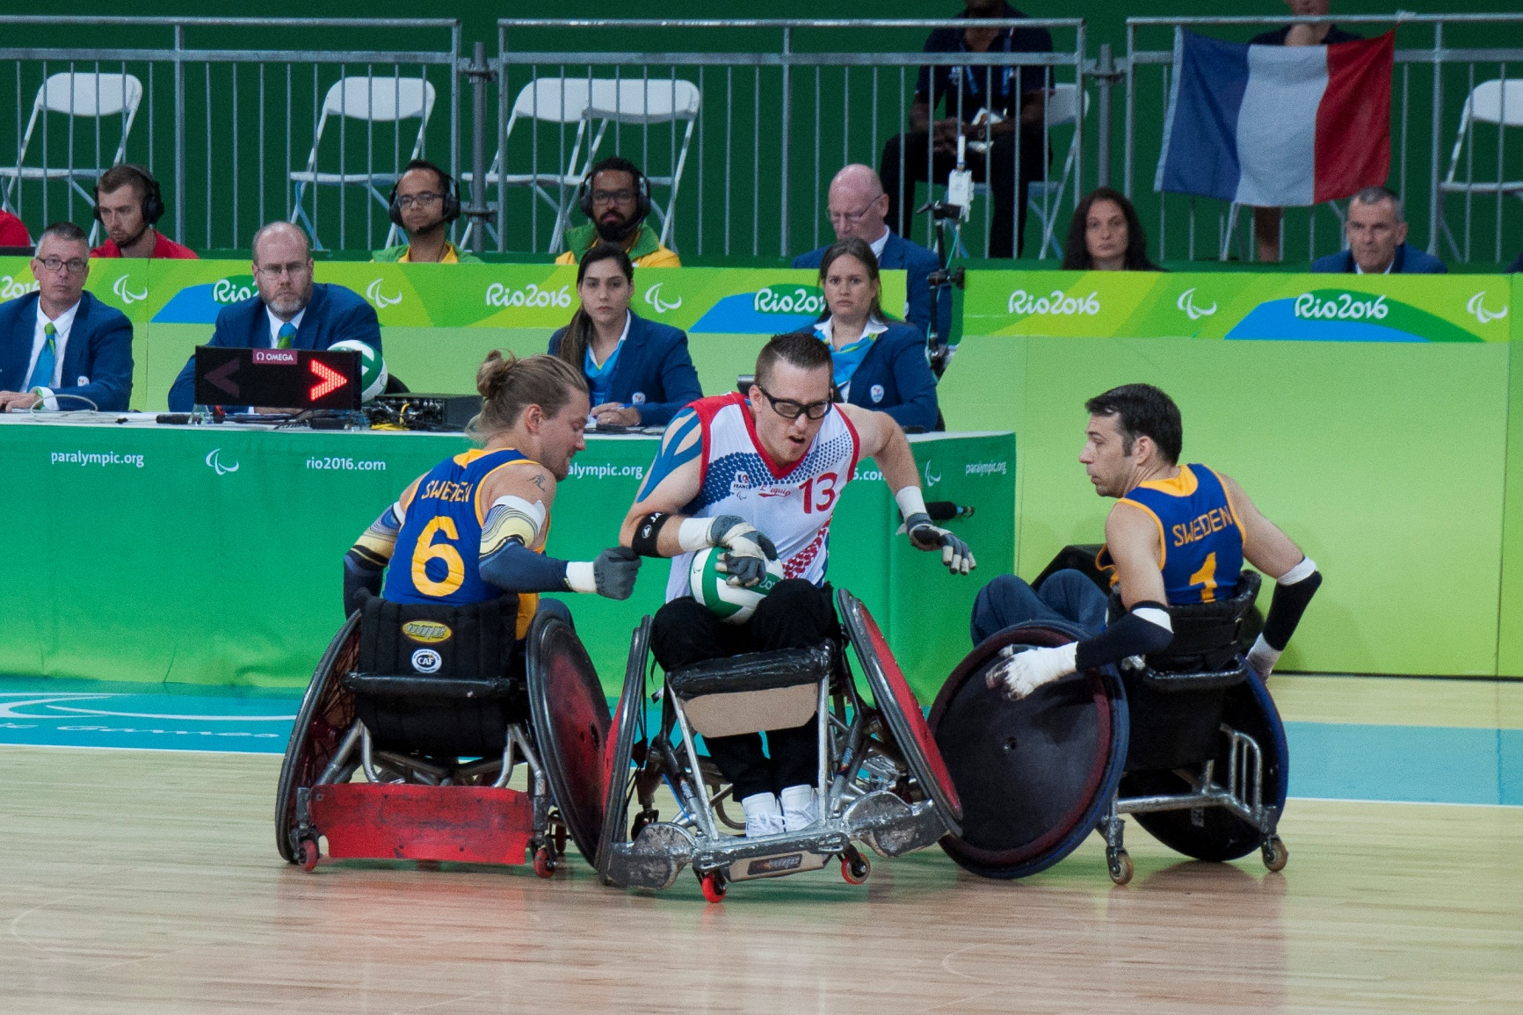
3.5, 3.0 & 0.5 class
Athlete on the left – 0.5 Trunk + UE bilateral 3.0; Athlete in the middle – 1.0 Trunk + UE bilateral 2.0; Athlete on the right – 0 Trunk + UE bilateral 0.5
Notes:
Player with blue jersey on the left is Tobias Sandberg, who has 0.5 trunk and bilateral 3.0 hands.
Player with white jersey in the Christophe Salegui from France. He has CMT with a 1.0 trunk and bilateral 2.0 hands. Watch the trunk position and the tilt of the chair that indicate a minimum trunk function of 1.0.
Player with the blue jersey on the right is Glen Adaszak his class is 0.5 based on bilateral 0.5 arms. Watch the kyphotic position in the chair, the forearms hooking under the rim in the rear quarter of the wheel and the abducted shoulders.

Slide 49
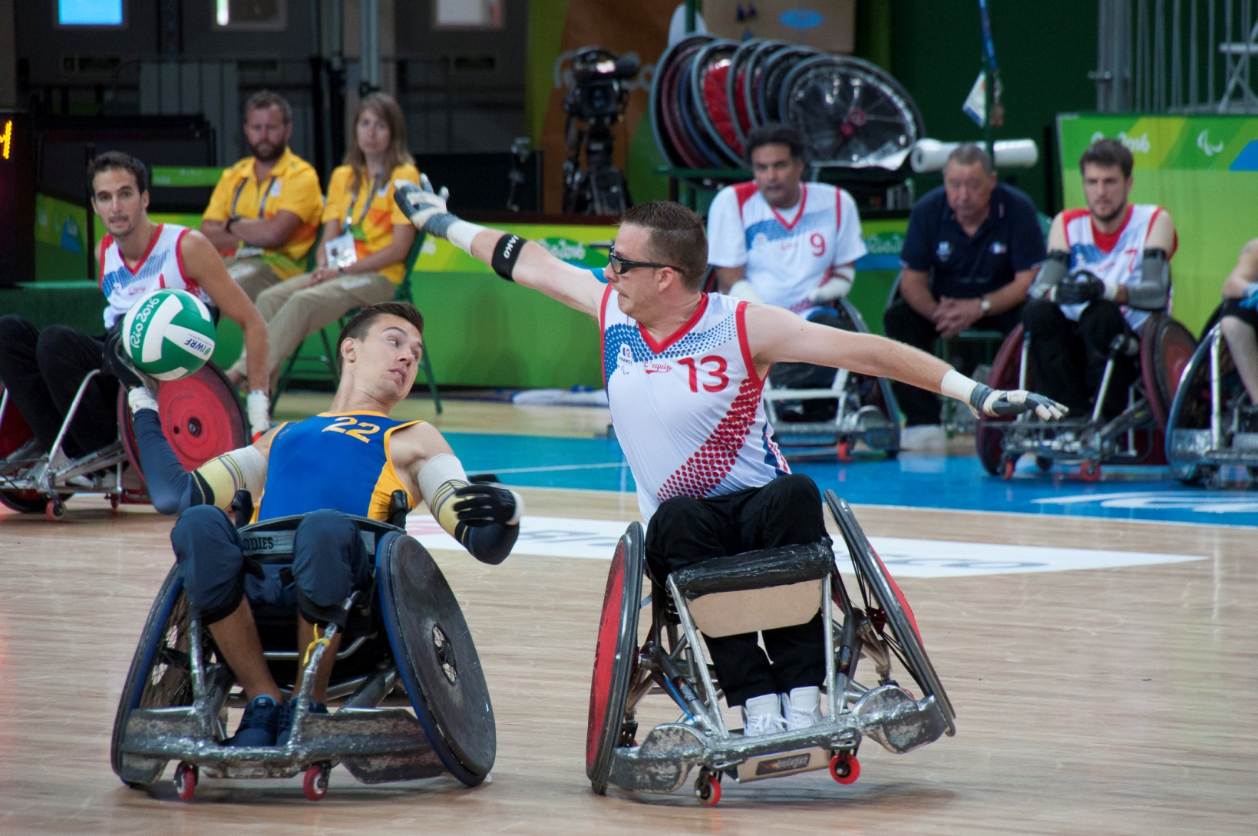
3.0 & 2.5 class
Athlete with white jersey – 3.0 class (1.0 trunk); Athlete with blue jersey – 2.5 class (0 Trunk)
Notes:
Player in white is 3.0 with 1.0 for trunk.
Player in blue is 2.5 with 0 for trunk.
Watch difference in seating position and seat dump and difference in trunk position.

Slide 50
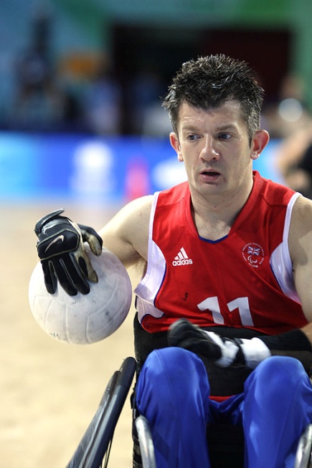
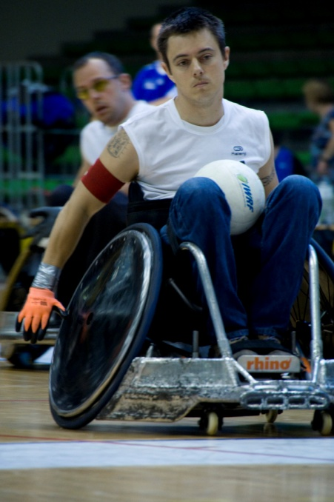
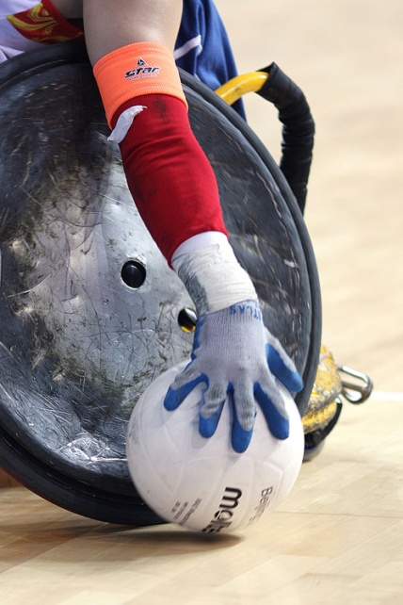
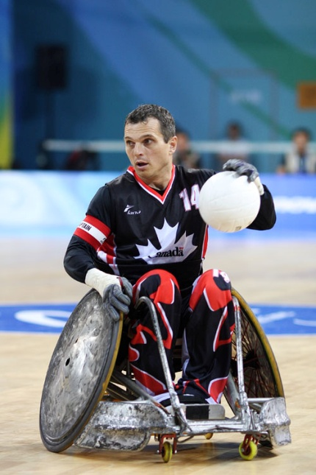
2.0 class
This same class, different athletes
Notes:
In one class there can be different athletes. All athletes have no hand function. But using the right gloves, sticky material and compensations it can look very deceiving on court! Try if you can see how the manage to hold the ball in one hand.

Slide 51

Sport Class Status
If a Classification Panel allocates a Sport Class to an athlete, it must also designate a Sport Class Status.
Sport Class Status indicates whether or not an athlete will bee required to undertake Athlete Evaluation in the future; and if the Athlete’s Sport Class may be subject to Protest.
New (N)
Review (R)
Review with a Fixed Review Date (FRD)
Confirmed (C)

Slide 52
New (N)
An Athlete is allocated Sport Class Status New (N) by the WWR prior to attending the Athlete’s first Evaluation Session.
An Athlete with Sport Class Status New must attend an Evaluation Session prior to competing at any International Competition.
If an Athlete, who enters the Competition with Sport Class Status New, does not complete First Appearance, the OA tracking code is removed and the Athlete is allocated CNC.

Slide 53
Review (R)
An athlete will be designated Sport Class Status R if the Classification Panel believes that further Evaluation Sessions will be required:
only recently entered Competitions licensed or recognised by the WWR;
If the WWR changes any Sport Class criteria and/or assessment methods, WWR may reassign any athlete who holds Sport Class Status C or FRD with Sport Class Status R and require that the athlete attend an Evaluation Session at the earliest available opportunity.
has a fluctuating and/or progressive Impairment/ Impairments that is/are permanent but not stable;
has not yet reached full muscular skeletal or sports maturity.

Slide 54
Review (R)
The Athlete may apply with the WWR for an exception to this two-year time period based on medical or health conditions that have had an effect on the Athlete’s ability to participate in Wheelchair Rugby.
An Athlete who enters a Competition with R Status that is not resolved at the Competition, will have a two-year time period in which to complete Athlete Evaluation; after which date the R Status will convert to CNC and the Athlete will no longer have a valid Sport Class or Sport Class Status.

Slide 55
Review (R)
If Classification Panel consists of less than 3 classifiers must designate an athlete with R Status (no possible to designate Status FRD or C).
The Athlete who has R Status because of a progressive health condition may continue to have Review Status without an expiration date.

Slide 56
Review with Fixed Review Date (FRD)
An Athlete may be designated Sport Class Status FRD if the Classification Panel believes that further Athlete Evaluation will be required but will not be necessary before 11 months, being the FRD.
The abbreviations FRD 1 and FRD 2 are used as a tracking code to indicate the first and second occasions that an athlete has completed Classification and remained in the same sport class.

Slide 57
Confirmed (C)
An Athlete with Status C is not required to undergo any further Athlete Evaluation (except Protest, Medical Review and changes to Sport Class criteria).
An Athlete will be designated with Status C if the Classification Panel is satisfied that both the Athlete’s Eligible Impairment and the Athlete’s ability to execute the specific tasks and activities fundamental to the sport are and will remain stable, which is defined as no change in the Athlete’s Sport Class at the conclusion of three consecutive Competitions that are a minimum of 11 months apart.

Slide 58

Classification Not Completed (CNC)
If at any stage of Athlete Evaluation, Classification Panel is unable to allocate a Sport Class to an athlete, HoC/ CC may designate that athlete as CNC.
CNC = no Sport Class, an athlete may not complete

Slide 59
Reasons for CNC
a failure on the part of the athlete to comply with any part of Classification Rules
a failure on the part of the athlete to provide any medical information that is reasonably required by the Classification Panel
the Classification Panel believes that the use (or non-use) of any medication and/or medical procedures/device/implant disclosed by the Athlete will affect the ability to conduct its determination in a fair manner
the Athlete is unable to communicate effectively with the Classification Panel
Notes:
A Classification Panel, in consultation with the Chief Classifier, may suspend an Evaluation Session if it cannot allocate a Sport Class to the Athlete, including but not limited to, one or more of the following circumstances:

Slide 60
Reasons for CNC
the Athlete has a Health Condition that may limit or prohibit complying with requests by the Classification Panel during an Evaluation Session, which the Classification Panel considers will affect its ability to conduct the Evaluation Session in a fair manner
the Athlete refuses or is unable to comply with any reasonable instructions given by any Classification Personnel to such an extent that the Evaluation Session cannot be conducted in a fair manner
the Athlete’s representation of his or her abilities is inconsistent with any information available to the Classification Panel to such an extent that the Evaluation Session cannot be conducted in a fair manner.
Notes:
A Classification Panel, in consultation with the Chief Classifier, may suspend an Evaluation Session if it cannot allocate a Sport Class to the Athlete, including but not limited to, one or more of the following circumstances:

Slide 61
Suspension
an athlete is designated CNC = no Sport Class and not be able to compete at any competiton until an Evaluation Session can be competed with a Sport Class and Sport Class Status awarded
being precluded from presenting for classification at any competition for a specified time of up to three months
Second occurrence of suspension = up to 24 months
may be subject to further investigation into any possible Intentional Misrepresentation

Slide 62
Medical Review
A Medical Review Request must be made if a change in the nature or degree of an athlete’s impairment changes the athlete’s ability to execute the specific tasks and activities required by a sport in a manner that is clearly distinguishable from changes attributable to levels of training, fitness and proficiency.
any Athlete who has been allocated a Sport Class with Sport Class Status Confirmed (C) or Review with Fixed Review Date (FRD)

Slide 63

Classification Protest
A Protest may not be made in respect of an Athlete who has been allocated Sport Class Not Eligible (NE)
A Protest may only be made in respect of an Athlete’s Sport Class, not of Status.
Protest can be made out of or during competition

Slide 64
Classification Protest
WWR Protest
WWR may, in its discretion, make a Protest at any time in respect of any athlete or as a result of a documented request from another NMO
National Protest
a National Member Organization (NMO) may only make a National Protest in respect of an athlete under its jurisdiction

Slide 65
Classification Protest
Protest panels can access any and all written documentation from previous athlete evaluations
Protest fee – National Protest or WWR Protest request
There is no limit of protest per athlete
Protests can be initiated following the athlete’s technical assessment

Slide 66
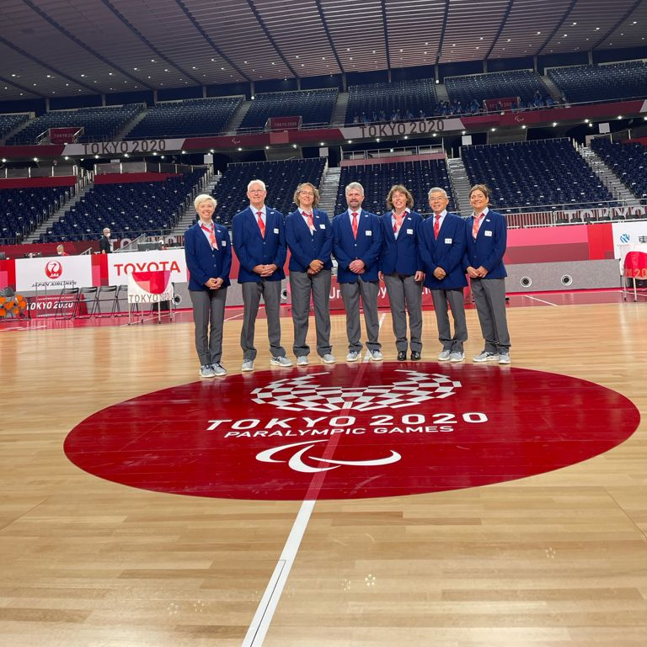
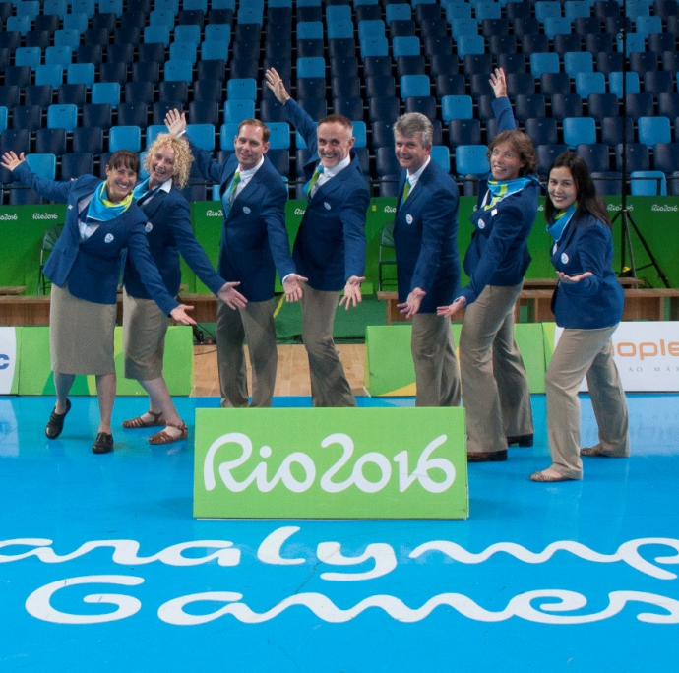

Wheelchair Rugby Classifiers
We WANT you to join our team!

