Slide 1
Contact at/near the try line
Presented by Technical Working Group
April 01, 2026

Slide 2
Framing the rule change
There is a need to increase the value placed on defensive effort and a need to reduce scoring
Clarity around the interpretation of contact at the tryline will address the findings of low spectator excitement and lack of spectator understanding when minimal effort is made to defend the try line.
Updates will incentivize defensive risk, which was identified as a need in the rules review
Addressing the data;
Scoring trend lines have been higher than 95%, over two Paralympic cycles. This can be addressed by incentivizing defense and increasing opportunities for turnovers.
The Member Nation survey supports technical video review showing limited to no injury occurring in hits at the try line over two Paralympic cycles.
Teams who have been sanctioned with 1 flagrant foul show lower risk tolerance to defend the try line. Teams often restrict the playing time of the athlete sanctioned to reduce risk of further penalty, or a game misconduct.
  This has been addressed by removing the game misconduct for a second flagrant in an event.

Slide 3
Principles of Contact
A referee must have good awareness of the principles used to evaluate contact, as well as good positioning.
Is the contact legal – contact is legal when a hit occurs at, or in front of, the rear axle. Officials should be well positioned to identify the point of contact. Consider that the bumper of the chair is up to 20cm wide. This allows for a wide range of contact to occur that is at or in front of the axel. E.g. A1 is hit at the axle, approximately 50% of the bumper is in front of the axle and 50% is behind the axle. This is legal contact.
  As the contact point moves beyond 40% of the bumper in front of the axle, the likelihood of the play resulting in a penalty increases.
Is the contact illegal, despite reasonable defensive effort – a reasonable effort is made to play legitimate defense on the ball or the chair, but the hit occurs late and offense is placed at a disadvantage or moved into an illegal position.

Slide 4
Principles continued...
Is the contact unsporting
  there is no angle at which the defender can make an effort to play legal defense on the chair or the ball;
  the contact places the offense at significant risk;
  and the contact is Avoidable and Deliberate;
  Unsporting contact may be judged flagrant or escalated to a disqualifying penalty.
When contact is Unavoidable but not unsafe or Speed/Severity are not a factor, the referee may determine a common foul or no call is warranted. The referee may speak to the defender about the contact.

Slide 5
Assessing the play
The referee is expected to position themselves to assess every element of a hit.
  Identify the gap between the offensive and defensive chair and focus on the defensive action, not the result of the play
  Know what legal contact looks like and evaluate from there
  Consider whether the defender has an opportunity to stop the chair, push the offense into the post or create a turnover.
  If the action of the defender is not deliberate or unsporting, but is illegal and creates a disadvantage, the play should be considered a common foul
  If the action of the defender is illegal, unsporting (ie. no legal play could be made on the ball or chair) and the contact is deliberate, a flagrant or disqualifying penalty likely applies

Slide 6
Case Example 1
A1 = Offensive Player
B1 = Defensive Player
A1 is attacking the try line.
B1 is ahead of A1, near the far post.
B1 attacks A1 at the try line in an attempt to knock the ball loose.
B1 is late in making contact.
The contact occurs behind the axle of A1, causing A1 to fall to the floor.
The referee charges B1 with a flagrant foul.
Is the referee correct?

Slide 7
Case Answer
Answer: Incorrect.
The referee should charge B1 with a spinning foul and award a penalty try to Team A.
B1 had legal guarding position before attempting the hit.
There was a legitimate attempt to play the chair but B1 arrived late.
This is considered a reasonable attempt to play legal defence, despite the attempt resulting in a foul.

Slide 8
Case Example 2
A1 is attacking the try line at the top of the key.
B2 is able to catch, and move slightly ahead of, A1.
B2 feels there is a good angle and turns in to hit A1.
B2 makes contact in the middle of A1’s rear axle
(Approximately 50% of B2’s bumper is behind A1’s axle and approximately 50% is in front of A1’s axle).
The contact causes A1 to fall forward to the floor.
A1 is in possession of the ball and touch their frame on the court.
The referee charges B2 with a flagrant foul and awards a penalty try to Team A.
Is this correct?

Slide 9
Case Answer
Answer: Incorrect.
B2 hit A1 in line with the axle and cause them to make contact with the floor while in possession of the ball.
This is a legitimate defensive play at the try line and should result in a turnover.
A1 shall be penalised with a Physical Advantage violation.
Team B shall receive the ball on the sideline at the location of the contact.

Slide 10
Video Examples

Slide 11
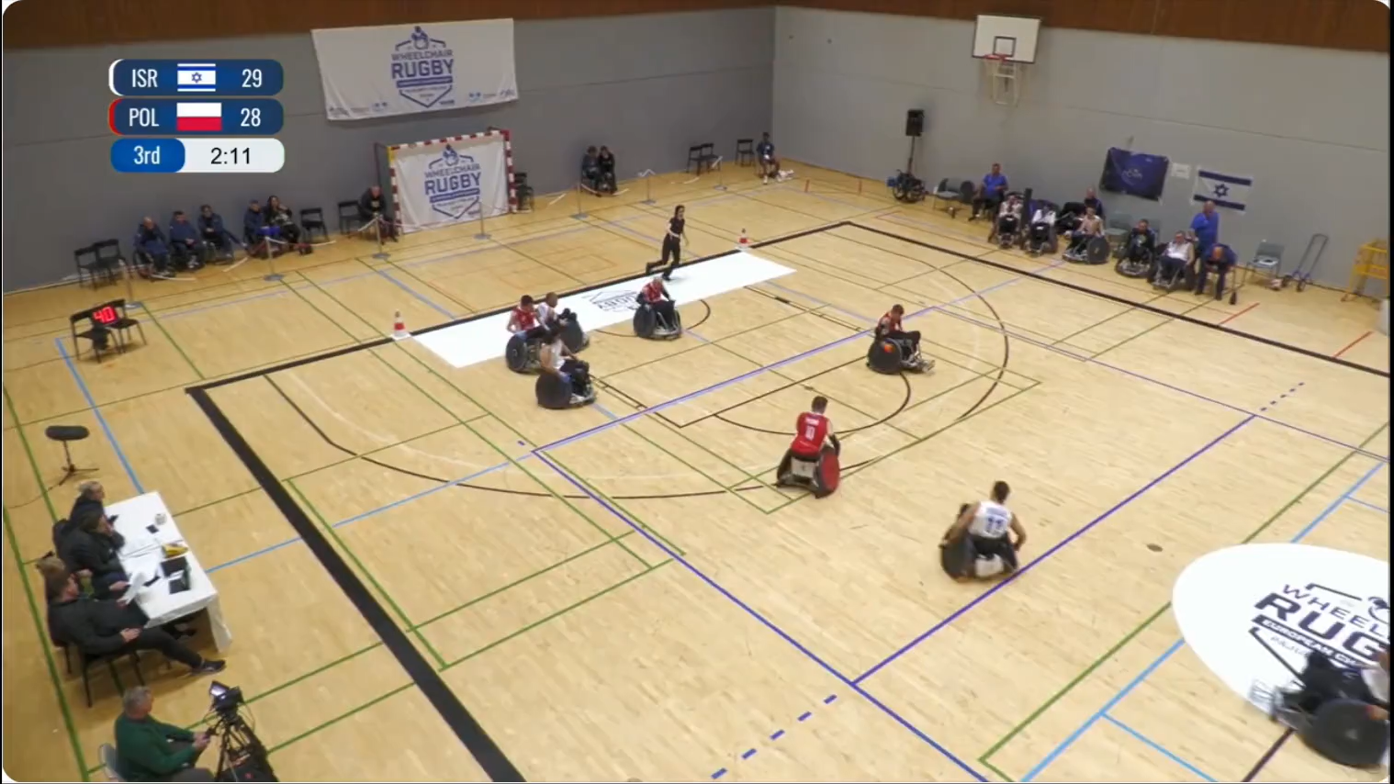
What do you see?
Is there opportunity for the defense to establish a reasonable angle of attack to the axle or play the ball?
Does the defender throws their hips in a last attempt to turn the chair?
Does the contact occur well behind the rear axle and castor?
Is this reasonable defensive effort given the speed of the play?
Is this unsportsmanlike play?
Photograph: Athlete name / Photographer owner

Slide 12
Video 1 answer
Answer: Flagrant foul.
There is no opportunity for the defense to establish a reasonable angle of attack to the axle or play the ball
The defender throws their hips in a last attempt to turn the chair
  While it is possible to have a good defensive play and turn the chair from behind the rear castor at slower speeds, the speed of this play does not meet the standard for good defensive effort
The contact occur well behind the rear axle and castor
This is unsportsmanlike play

Slide 13
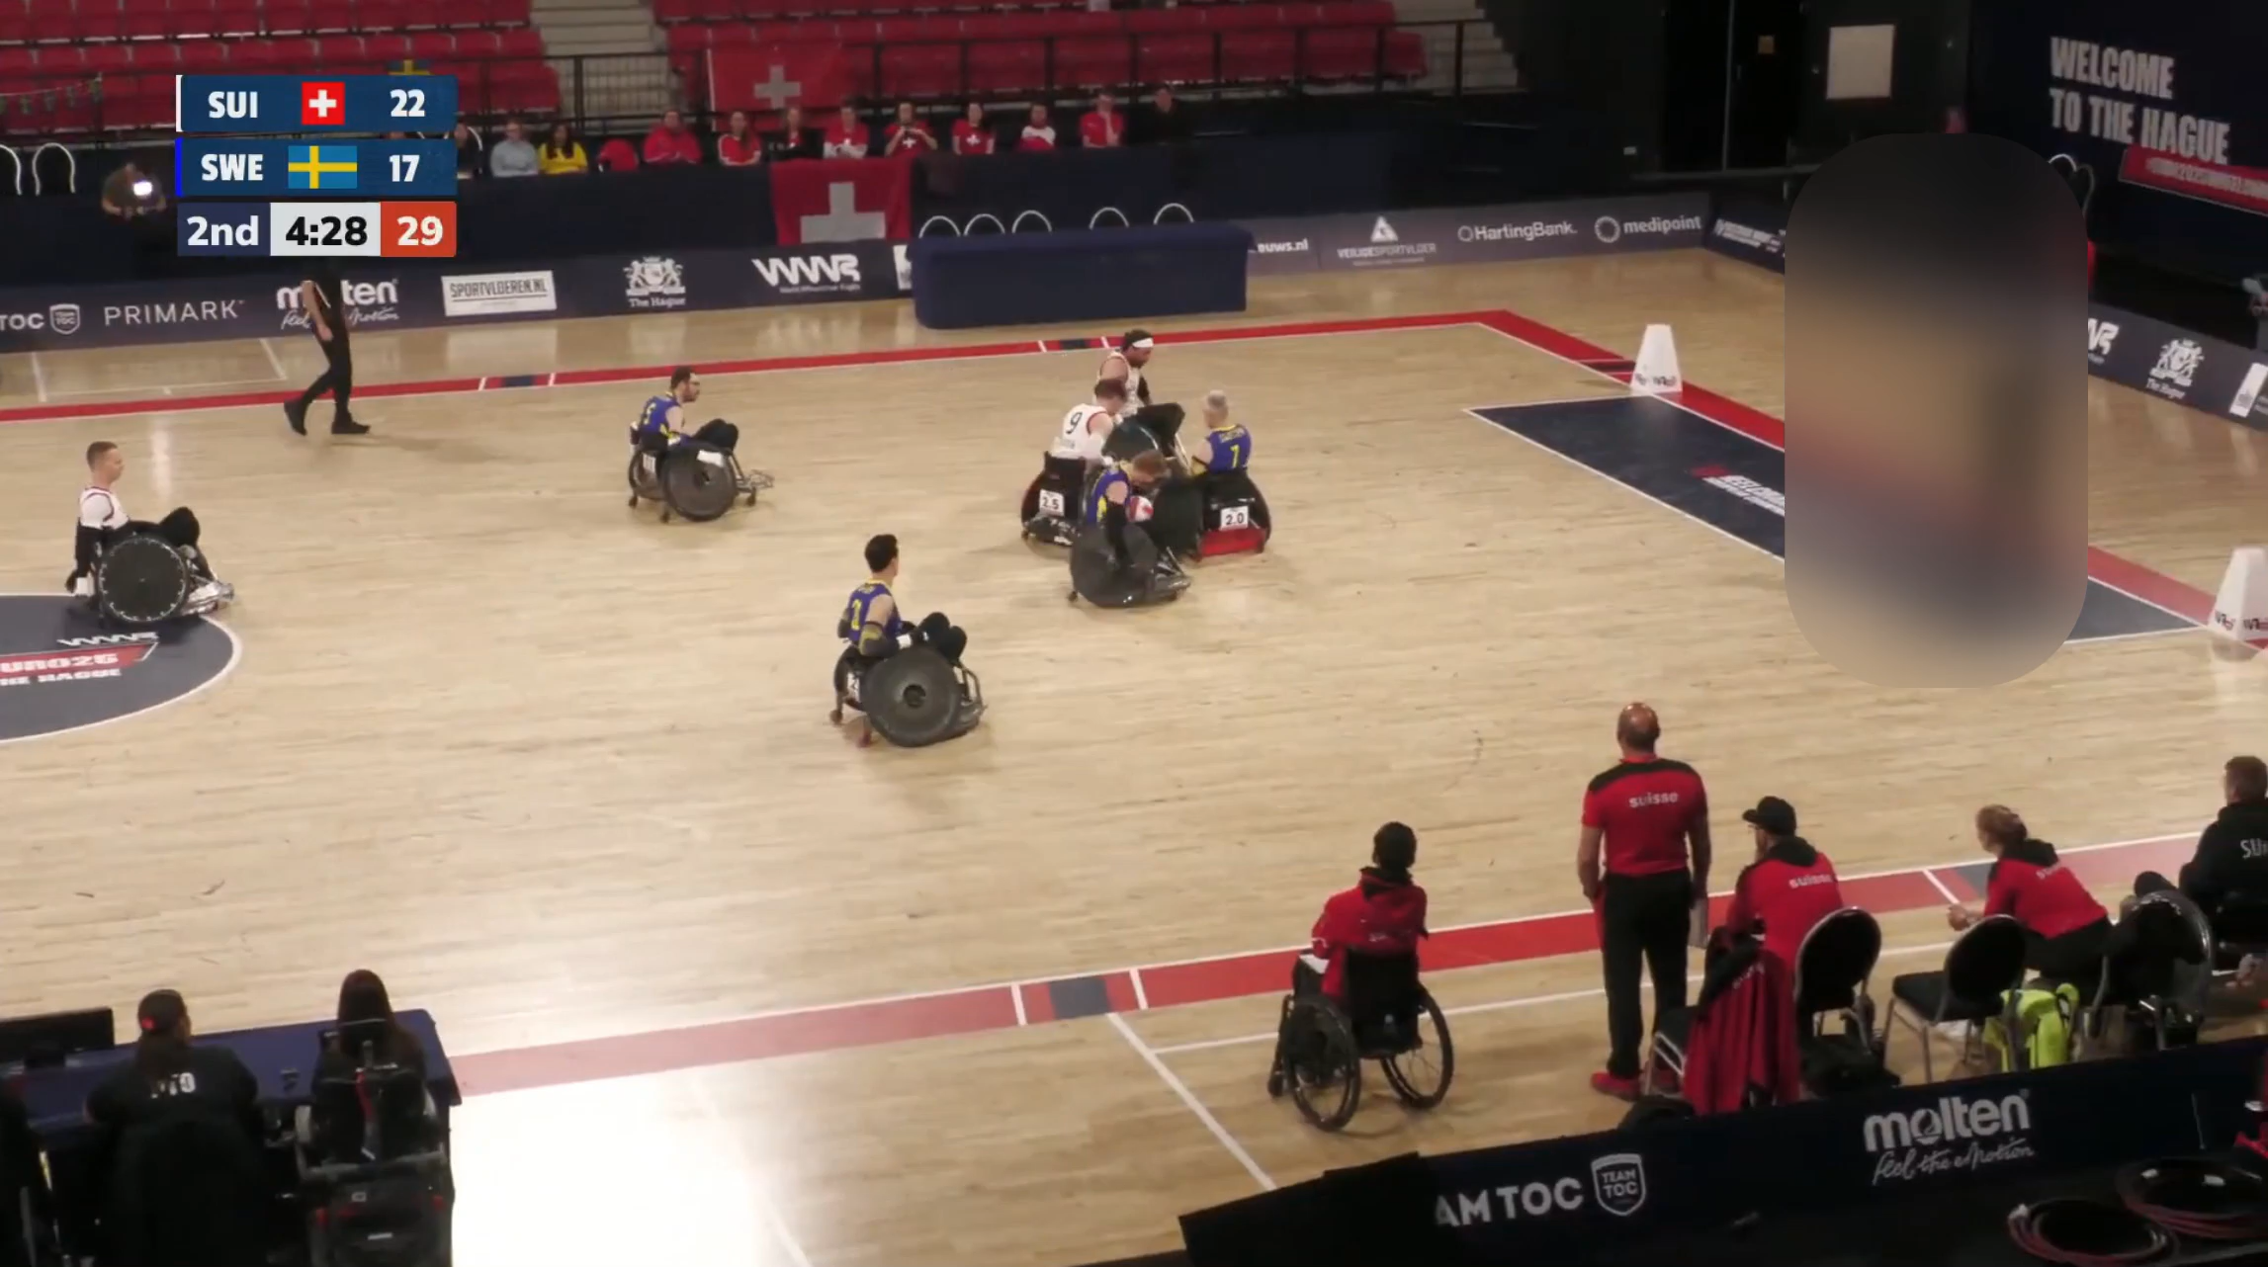
What do you see?
Is there opportunity for the defense to establish a reasonable angle of attack to the axle or play the ball?
Does the defender get in front of the offensive player and establish legal guarding position?
Does the contact occur at or behind the axle?
Is this reasonable defensive effort given the speed of the play?
Is this unsportsmanlike play?
Photograph: Athlete name / Photographer owner

Slide 14
Video 2 answer
Answer: Spin & Penalty Try.
The contact occured at or behind the axle
The defender pushes ahead of the offense, establishes legal guarding position, lines up to hit the side of the offensive players chair and arrives late. There is a reasonable angle of attack to the axle
This is a reasonable defensive effort given the speed of the play
The offense took a chance at a good hit and missed.
This is not unsportsmanlike play

Slide 15
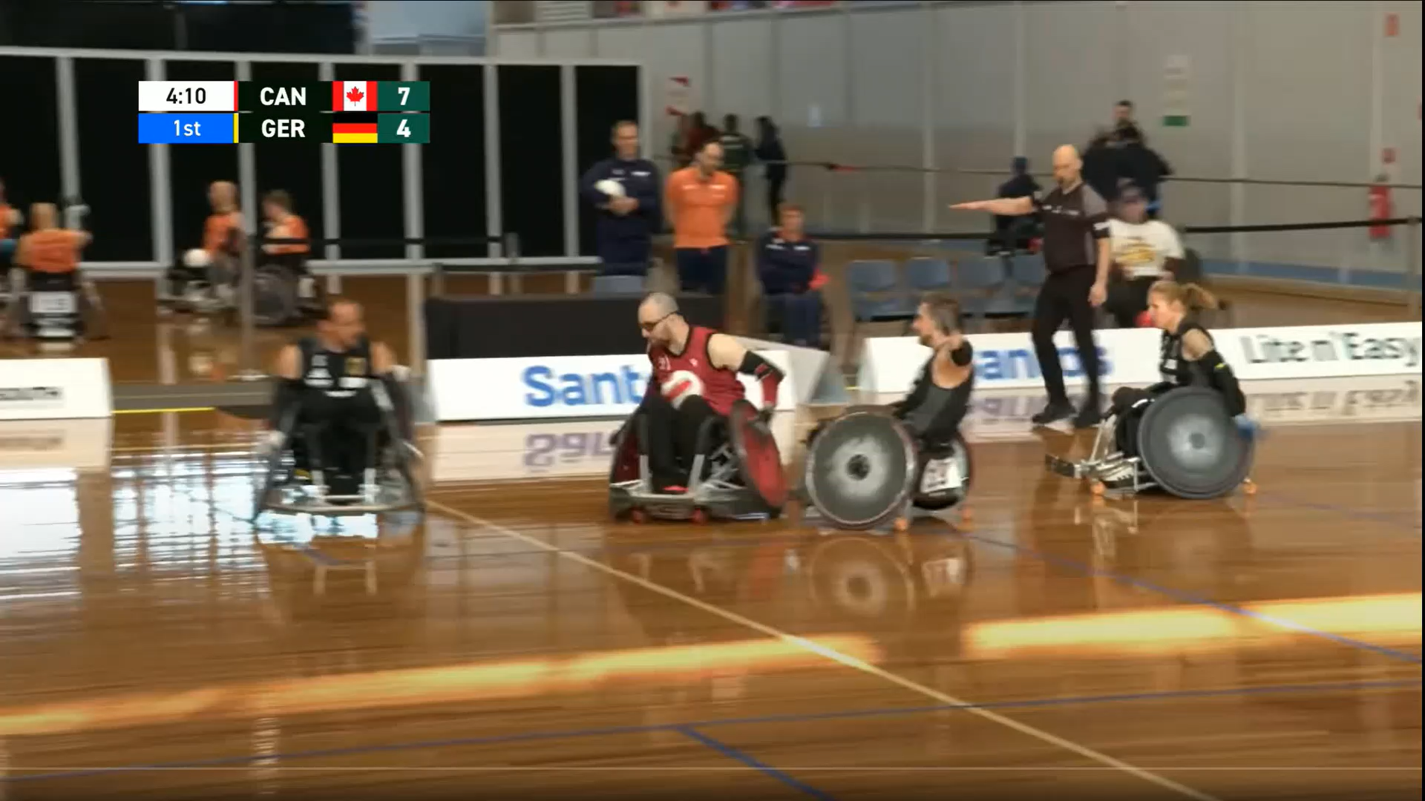
What do you see?
Does the defender maintain a reasonable angle of attack to the axle?
Did the defender start ahead of the offense – establishing legal guarding position?
Does the contact occur behind the axle?
Is this reasonable defensive effort to push the offensive player into the post?
Is this unsportsmanlike play?
Photograph: Athlete name / Photographer owner

Slide 16
Video 3 answer
Answer: Spin & Penalty Try.
The defender maintained a reasonable angle of attack to the axle
The defender starts ahead of the offense and established legal guarding position
Yes, the contact does occur just behind the axle
  If the contact had occurred at the axle, the play would have resulted in a no call, with a try awarded to the offense.
There is a reasonable defensive effort to push the offensive player into the post
  If the defense was successful in hitting the offense into the post, and the hit had occurred at the axle, a turnover is the correct call.
This is not unsportsmanlike play

Slide 17
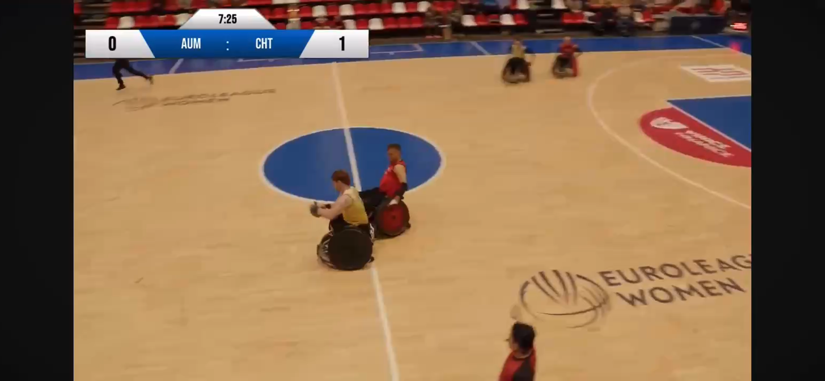
What do you see?
Does the defender maintain a reasonable angle of attack to the axle?
Who initiates the contact at the try post?
Does the contact occur at or in front of the axle?
Is this reasonable defensive effort to push the offensive player into the post?
Does the offense maintain ball control across the line?
Is this unsportsmanlike play?

Slide 18
Video 4 answer
Answer: Try, good hit.
Due to the angle of the video, it is difficult to determine if the two castors touch the line first or if the ball comes loose prior to the score.
The defender maintained a reasonable angle of attack to the axle and establishes a parallel path to the offense.
The offense turns into the defender to create an angle to the post. In doing so, initiates the contact at the try post.
The contact occurs at the axle
This is a reasonable defensive effort to push the offensive player into the post
Does the offense maintain ball control across the line
  this is difficult to determine due to the video angle.
Legal play

Slide 19
What we want to see
Officials who better understand good defensive tactics, angles and effort
Officials who watch the defense first
Officials who can identify when contact starts at, or in front, of the axle, and ignore the resulting effect to the offense – which may come from forward momentum, creating a drag effect.
Officials who identify the angle of attack the defender takes and connect this angle to defensive opportunity. Also, understand when the angle is such that no reasonable defense can be played, therefore the contact is unsportsmanlike.
Clearly identify when is it appropriate to give a try, a penalty try, common foul or turn over the ball and know when to escalate.

Slide 20
Questions?

